Slide 1
Marianna Zhang
Structural representations of categories
and why we should care
3rd year PhD student in Psychology with Ellen Markman
CiCL lab meeting
10.20.2020
Notes:
Hi to those I haven’t met before, I’m Marianna, she/her, …
I’m broadly interested in…
Please feel free to jump in as I go, would love to hear your thoughts

Slide 2
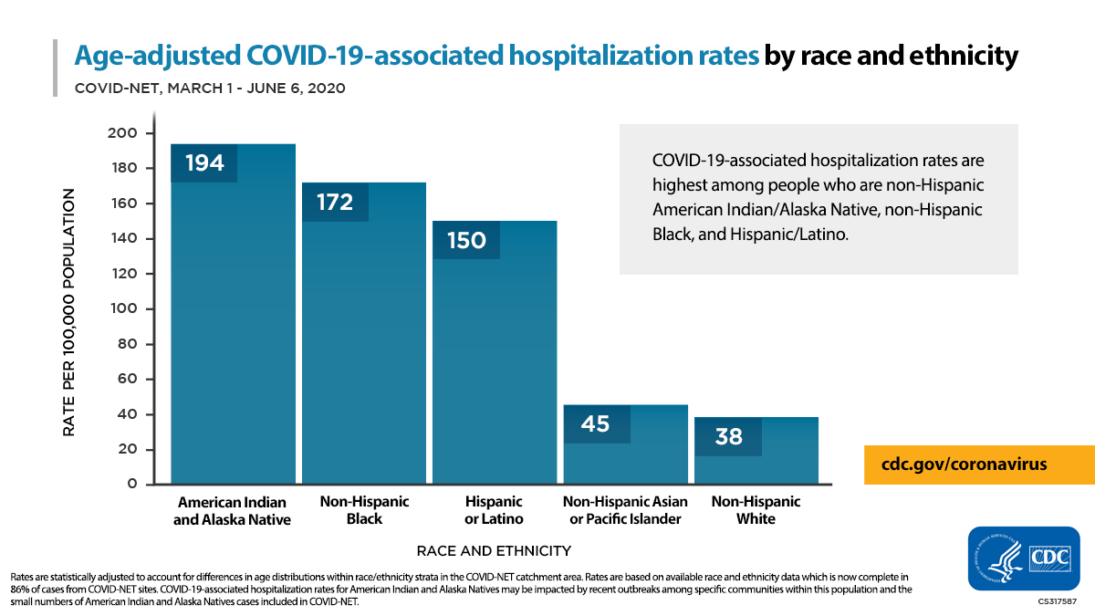
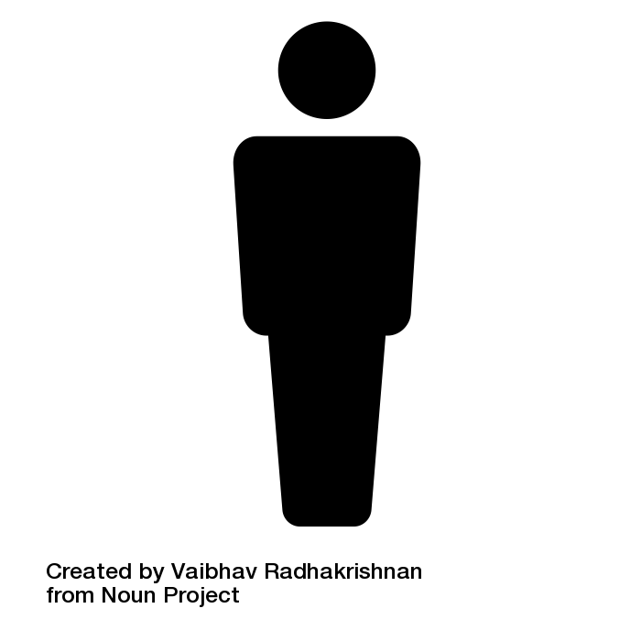
We observe different frequencies of a property across categories.
COVID-19
Notes:
When we look out at the world, we notice that some properties distributed differently across different categories.
For instance, during the current pandemic, Black (along with indigenous and Latinx) people have faced higher rates of hospitalization by COVID-19 than other racial groups.
We might wonder what the link is between being a member of these social categories, and being hospitalized by COVID-19.

Slide 3
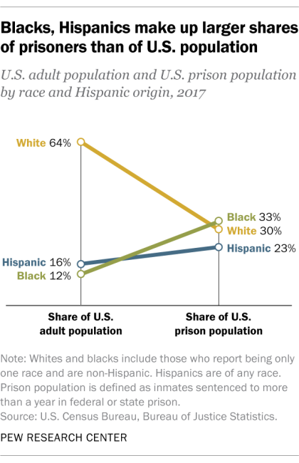
We observe different frequencies of a property across categories.
incarceration
Notes:
And if we look at who goes to jail, we see that Black people face higher rates of incarceration than other racial groups, as indicated by the steep green line.
We can say that Black people are disproportionately incarcerated

Slide 4
We observe different frequencies of a property across categories.
COVID-19
incarceration
Notes:
Might wonder, why is that the case? What might account for the different statistical frequencies observed between groups?

Slide 5
We observe different frequencies of a property across categories.
COVID-19
incarceration
Notes:
We might first wonder whether there really is a significant connection to care about here. Do some social groups experience significantly different rates of … or is it just a fluke?

Slide 6
We observe different frequencies of a property across categories.
X
X
COVID-19
incarceration
Accidental
Due to chance.
Nothing meaningful here, differences in frequency are not significant.
eh
Notes:
We might conclude that there is no meaningful pattern here. Just by chance that this group has higher rates, differences are not statistically not significant. Nothing to think about further.
This might result from some process of causal reasoning that outputs nothing (there is no cause), or failure to engage in causal reasoning entirely.
*NICKY: priors on likelihood of causes, causal connections (eg people who are unlikely to think race could be a reason)

Slide 7
We observe different frequencies of a property across categories.
?
?
COVID-19
incarceration
Accidental
Non-accidental
Due to chance.
Nothing meaningful here, differences in frequency are not significant.
Why?
Due to some cause.
Triggers search for causal structure.
Notes:
Non-accidental – Something meaningful here, some causal structure to uncover.
Concluding non-accidental is already powerful, eg getting people to acknowledge that racial disparities are real is already a huge step.
(ELLEN analogy: eg climate change: are these past few seasons significantly non-accidentally hotter?)

Slide 8
We observe different frequencies of a property across categories.
?
?
COVID-19
incarceration
Accidental
Non-accidental
Due to chance.
Nothing meaningful here, differences in frequency are not significant.
Why?
Due to some cause.
Triggers search for causal structure.
Notes:
Let’s follow what happens if we think the patterns are non-accidental. Property is disproportionately frequent among members of a category for non-accidental reasons.
Triggers search for an explanation, for some causal structure.
What might the underlying causal structure be?

Slide 9
Potential causes for observed group differences
?
COVID-19
Why?
Notes:
Let’s take the COVID-19 example. Why might Black people be disproportionately infected by COVID-19?
Type into chat: what might the cause of this be?

Slide 10
Potential causes for observed group differences
limited access to healthcare
multi-generational households
essential jobs w high exposure risk
biologically vulnerable
Why?
COVID-19
Notes:
Let’s take the COVID-19 example. Why might Black people be disproportionately infected by COVID-19?
Biologically predisposed. Pre-existing conditions, asthma, COPD, etc
Multi-generational households
Essential jobs with high exposure risk
Limited access to healthcare

Slide 11
Potential causes for observed group differences
housing segregation
limited economic opportunities
culture
polluted neighborhoods
limited access to healthcare
multi-generational households
essential jobs w high exposure risk
biologically vulnerable
Why?
COVID-19
Notes:
These causes could be interrelated of course, and we can add many more causes into the causal model
Essential jobs often come with poor health insurance, which may limit healthcare access
Limited healthcare access may lead to the development of medical conditions, social determinants of health
Limited economic opportunities might lead young adults to continue living with their families
Housing segregation leads people to live in polluted neighborhoods with poorly funded hospitals
*DAVID: causal background. What causes are there, vs causal selection: what is the cause

Slide 12
Potential causes for observed group differences
?
incarceration
Why?
Notes:
For incarceration likewise, there are a variety of causes that people have claimed. I’ll just flash a few that I’ve heard up on the screen, with the heads-up that some of these are uh not in my personal causal model.
As you’ve seen from the COVID example, these different causal models, or different construals, of what’s going on can get really complicated and complex.
One way we can get an initial handle on these models is by categorizing them by what kinds of causes they cite, and drawing some initial distinctions along those lines.

Slide 13
Potential causes for observed group differences
limited economic opportunities
culture of violence
gangs
racial bias in policing
racial bias in law & sentencing
criminal disposition
Why?
incarceration
Notes:
For incarceration likewise, there are a variety of causes that people have claimed. I’ll just flash a few that I’ve heard up on the screen, with the heads-up that some of these are uh not in my causal model.
As you’ve seen from the COVID example, these different causal models, or different construals, of what’s going on can get really complicated and complex.
One way we can get an initial handle on these models is by categorizing them by what kinds of causes they cite, and drawing some initial distinctions along those lines.

Slide 14
Potential causes for observed group differences
criminal disposition
Why?
incarceration
Notes:
Looking at these different potential causes, I have the intuition – that I hope you share - that someone whose causal model looks like this and thinks that a criminal disposition is the cause of incarceration rates will probably have very different attitudes towards Black people and towards incarceration, than someone who thinks that it’s racial bias and/or limited economic opportunities, than someone who thinks it’s a culture of violence.

Slide 15
Potential causes for observed group differences
limited economic opportunities
gangs
racial bias in policing
racial bias in law & sentencing
Why?
incarceration
Notes:
Looking at these different potential causes, I have the intuition – that I hope you share - that someone whose causal model looks like this and thinks that a criminal disposition is the cause of incarceration rates will probably have very different attitudes towards Black people and towards incarceration, than someone who thinks that it’s racial bias and/or limited economic opportunities, than someone who thinks it’s a culture of violence.

Slide 16
Potential causes for observed group differences
culture of violence
gangs
Why?
incarceration
Notes:
Looking at these different potential causes, I have the intuition – that I hope you share - that someone whose causal model looks like this and thinks that a criminal disposition is the cause of incarceration rates will probably have very different attitudes towards Black people and towards incarceration, than someone who thinks that it’s racial bias and/or limited economic opportunities, than someone who thinks it’s a culture of violence.

Slide 17
Potential causes for observed group differences
limited economic opportunities
culture of violence
gangs
racial bias in policing
racial bias in law & sentencing
criminal disposition
Why?
incarceration
Notes:
These models all seem to cite very different types of causes

Slide 18
Construals by the type of cause cited as the cause
?
?
?
property
Notes:
So let’s try to think about these different causal models – or construals - by the type of cause they would cite as the cause. recognizing that these models can get pretty complex, as we saw, so I’m going to drastically oversimplify for the sake of taking a first stab

Slide 19
causes internal to individuals in group
biology, personality, disposition
(including biological essentialism)
biologically vulnerable
criminal disposition
COVID-19
incarceration
Gelman, 2003
Notes:
Focus is on something inside of the individual
Including what has traditionally been thought of as essentialism, including its most extreme form: biological essentialism. Each group member has some innate, temporally stable biological essence that causally produces observed category properties, eg DNA, genes

Slide 20
causes external to an individual but internal to the group
culture, shared values/beliefs
culture of violence
incarceration
Notes:
Focus is on…
Culture is an interesting case that is external to any single individual, but certainly located within the group. Inspired by debates about cultural essentialism
*non-social: animal conspecific interactions, social hierarchies

Slide 21

causes external to the group
policies, discrimination, environment, social systems, economic systems
essential jobs w high exposure
racial bias in policing
COVID-19
incarceration
Notes:
Causes external to the group that act on the group as a whole
Policies that target the social group
In some ways like person vs situation contrast in social psychology, but on a group level: situations that the group occupies or regularly finds themselves in
Focusing here on social examples, but just want to tangentially mention that these types of causes aren’t exclusive to the social domain. Animals that now exhibit certain evolutionarily novel properties due to human domestication, factory farming. Organisms that exhibit certain properties when controlled by predators in their native environment, but once introduced elsewhere where they are not under such ecological pressure, become invasive species. Elements/minerals that tend to take certain structure and from because they are mostly found in the earth’s crust at high temperature and pressure, but once removed from that environment, properties change.

Slide 22

Different construals cite different types of causes.
causes internal to individuals in group
biology, personality, disposition
causes external to an individual but internal to the group
culture, shared values/beliefs
causes external to the group
policies, discrimination, environment, social/economic systems
Notes:
Recap: we can think of construals - in a very roughly and grossly simplified way – in terms of the kind of cause they primarily cite

Slide 23
Different construals cite different types of causes.
causes internal to individuals in group
biology, personality, disposition
Biological
Internalist
causes external to an individual but internal to the group
culture, shared values/beliefs
Cultural
causes external to the group
policies, discrimination, environment, social/economic systems
Structural
following Haslanger; Vasilyeva et al., 2018
Notes:
Follow Nadya
Label this structural
These construals – prototypically biological and culture - have all been considered internalist in past literature, but I think it’s useful to consider them separately, since culture is an interesting in-between case

Slide 24
What kinds of input
lead us to these different construals?
causes internal to individuals in group
biology, personality, disposition
Biological
Internalist
causes external to an individual but internal to the group
culture, shared values/beliefs
Cultural
causes external to the group
policies, discrimination, environment, social/economic systems
Structural
Notes:
Interlude: In another line of work, I’ve been very interested in what kinds of input lead us to these different construals.

Slide 25
What kinds of input
Statistical evidence
Property is disproportionately frequent among that category.
lead us to these different construals?
causes internal to individuals in group
biology, personality, disposition
Biological
Internalist
causes external to an individual but internal to the group
culture, shared values/beliefs
Cultural
causes external to the group
policies, discrimination, environment, social/economic systems
Structural
Notes:
We’ve seen that statistical evidence that the property is disproportionately frequent among members of that category can be consistent with any of these construal.
What about statistical evidence about causes? Can certainly build some causal model if you can observe the causes, but many of the example causes we discussed are hard to witness statistical evidence of: hard to see a criminal disposition, a culture of violence, or limited economic opportunities

Slide 26
What kinds of input
Statistical evidence
Property is disproportionately frequent among that category.
Language
Generics: “Black people end up in prison.”
Formal explanations: “He ended up in prison because he’s Black.”
lead us to these different construals?
causes internal to individuals in group
biology, personality, disposition
Biological
Internalist
causes external to an individual but internal to the group
culture, shared values/beliefs
Cultural
causes external to the group
policies, discrimination, environment, social/economic systems
Structural
Notes:
I’m particularly interested in the role of language here. Some kinds of language like generics and formal explanations have been argued to be cues for an internalist model, but mounting evidence suggests both kinds of language can support any kind of model.
I’ve been interested in understanding what kinds of input lead to each construal, because ideally once we understand that, we can understand what kinds of input to provide, to promote one construal or another.

Slide 27
What kinds of input
(Tessler & Goodman, 2019, Noyes & Keil, 2019/2020, Vasilyeva & Lombrozo, 2020)
Statistical evidence
Property is disproportionately frequent among that category.
Language
Generics: “Black people end up in prison.”
Formal explanations: “He ended up in prison because he’s Black.”
lead us to these different construals?
causes internal to individuals in group
biology, personality, disposition
Biological
Internalist
causes external to an individual but internal to the group
culture, shared values/beliefs
Cultural
causes external to the group
policies, discrimination, environment, social/economic systems
Structural
What are the downstream consequences?
Notes:
I’m particularly interested in the role of language here. Some kinds of language like generics and formal explanations have been argued to be cues for an internalist model, but mounting evidence suggests both kinds of language can support any kind of model.
But to return to the project at hand, I’ve been interested in understanding what kinds of input lead to each construal, because ideally once we understand that, we can understand what kinds of input to provide, to promote one construal or another.
But which construal do we want to promote? Why does it matter which construal people use to explain category properties? What are the downstream consequences of these different construals?

Slide 28
What kinds of input
(Tessler & Goodman, 2019, Noyes & Keil, 2019/2020, Vasilyeva & Lombrozo, 2020)
Statistical evidence
Property is disproportionately frequent among that category.
Language
Generics: “Black people end up in prison.”
Formal explanations: “He ended up in prison because he’s Black.”
lead us to these different construals?
causes internal to individuals in group
biology, personality, disposition
Biological
Internalist
causes external to an individual but internal to the group
culture, shared values/beliefs
Cultural
causes external to the group
policies, discrimination, environment, social/economic systems
Structural
What are the downstream consequences?
Notes:
What are the downstream consequences of these construals?
I have the intuition that what construal you take to be the case will lead to really different downstream attitudes, beliefs, and behaviors, but… it’s possible to think that eh whichever model you take to be the case, you’re looking out at the same pattern of statistical evidence at the end of the day.
Although we might be looking at the same pattern of statistical evidence, of what is the case, depending on what model we take, we might have different attitudes and beliefs about that evidence. In this project, I’ll focus on 3 downstream consequences

Slide 29
What kinds of input
Statistical evidence
Property is disproportionately frequent among that category.
Language
Generics: “Black people end up in prison.”
Formal explanations: “He ended up in prison because he’s Black.”
lead us to these different construals?
causes internal to individuals in group
biology, personality, disposition
Biological
Internalist
causes external to an individual but internal to the group
culture, shared values/beliefs
Cultural
causes external to the group
policies, discrimination, environment, social/economic systems
Structural
What are the downstream consequences?
Normativity What should be the case?
Possibility of change Is it possible for things to be otherwise?
Target of intervention How might we change what is the case?
Notes:
In particular, we might have different attitudes about: 1) what should be the case. In particular, would it okay if a category member didn’t exhibit the property? Or would you consider them in the wrong, and enforce the norm against them. *ELLEN: focus on non-conforming category members. Norm enforcement.
whether it’s possible for what’s currently the case to be otherwise
how one would even go about changing what’s currently the case. Inspired by the thought that different causal models should support different interventions, and lead to support for different policies.
Of course each of these downstream beliefs are also affected by other factors, such as the statistical prevalence of the property, and the prior valence of the property/social group, but here focusing on the effects of the construal.

Slide 30
What are the downstream consequences of different construals?
Calibration > Intro/contrast > Construal > Possibility of change > Normativity > Intervention
N = 150 US-based adults on MTurk
N = 132 after exclusions (attention checks) (~44/condition)
In this task, you'll read a story about groups that live on a planet far far away. Please read the story carefully. You'll be asked to answer some questions about the groups.
We hope the task can be done at a future point by children, so the language is designed to be kid-friendly.
Notes:
Very fresh pilot data, excited for your thoughts. Pilot w adults, goal is eventually to test with kids, 5-6yo
(click) high-level overview is that we introduce participants to novel social groups and novel property of those social groups, participants are randomly assigned to hear one of 3 kinds of explanations inducing biological, cultural, or structural construal, 3 measures in fixed order
Based on a simulation power analysis, ran 150 adults on MTurk, 132 after exclusions.
Run you through the study and predictions, then show you the data
Participants saw everything indicated in the boxes

Slide 31
What are the downstream consequences of different construals?
Calibration > Intro/contrast > Construal > Possibility of change > Normativity > Intervention
Let's get started by practicing with some questions.
Can people shower in the morning instead of at night? (Y/N)
Can people walk through walls? (Y/N)
Is it okay or not okay if someone steals money from their friend? (okay/not okay)
Is it okay or not okay if someone gives a gift to their friend? (okay/not okay)
Calibrate
Possibility of change
Normativity
Feedback for each
Actually, no. / That’s right!
People can't walk through walls, because walls are solid and we can't pass through them.
N = 132 adults on MTurk
~44/condition
Notes:
Calibration questions
Normativity: wide range, stats norm, moral

Slide 32
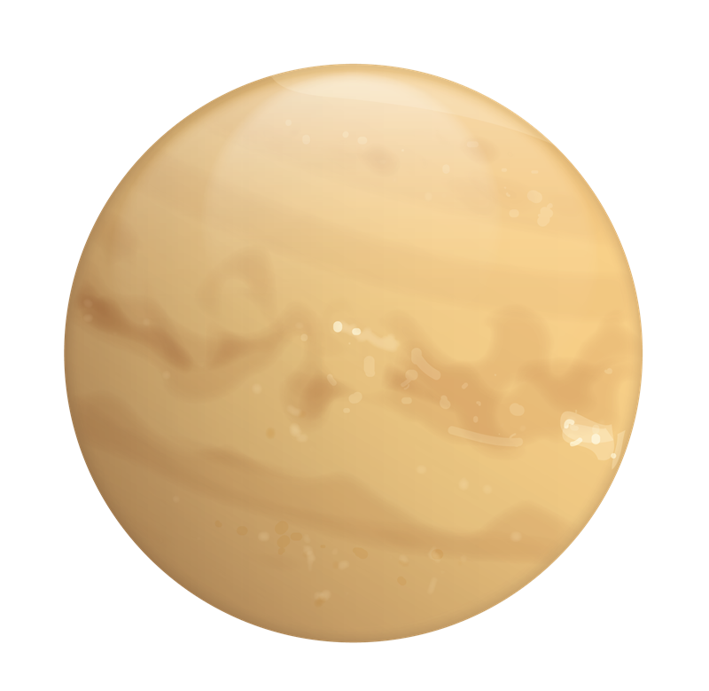
What are the downstream consequences of different construals?
Calibration > Intro/contrast > Construal > Possibility of change > Normativity > Intervention
Great, let's get started!
I am going to tell you about a planet far away.
novel setting
N = 132 adults on MTurk
~44/condition

Slide 33
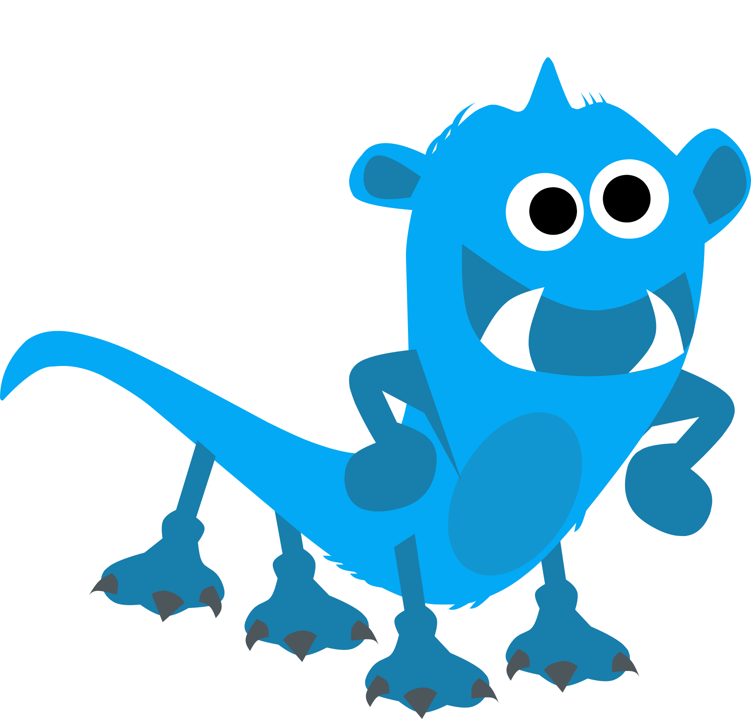
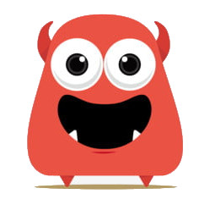
What are the downstream consequences of different construals?
Calibration > Intro/contrast > Construal > Possibility of change > Normativity > Intervention
There are 2 kinds of friendly aliens who live on this planet: Zarpies and Vawns.
novel social groups
N = 132 adults on MTurk
~44/condition
Notes:
Novel social groups

Slide 34
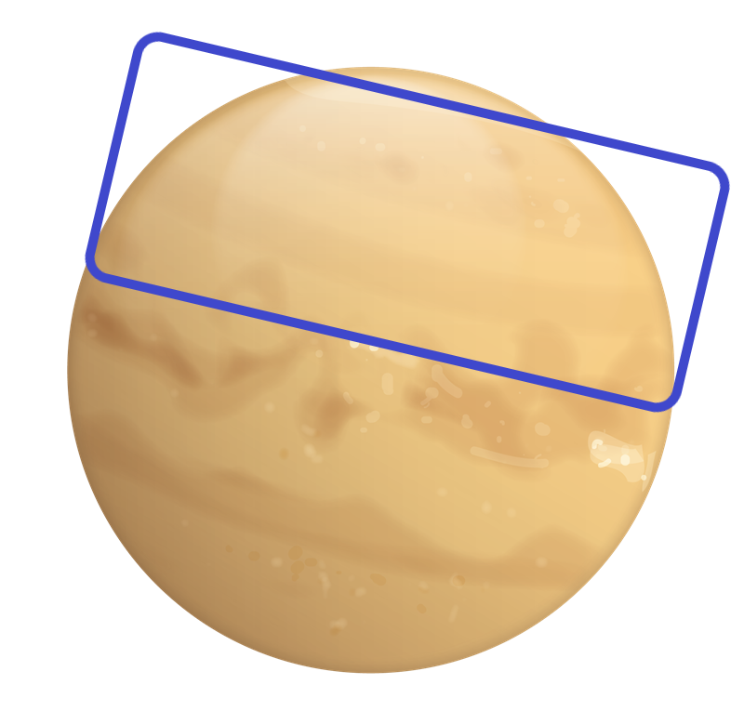
What are the downstream consequences of different construals?
Calibration > Intro/contrast > Construal > Possibility of change > Normativity > Intervention
Zarpies live here, on this side of the planet.
structural context
N = 132 adults on MTurk
~44/condition
Notes:
Structural context: environmental/residental segregation

Slide 35
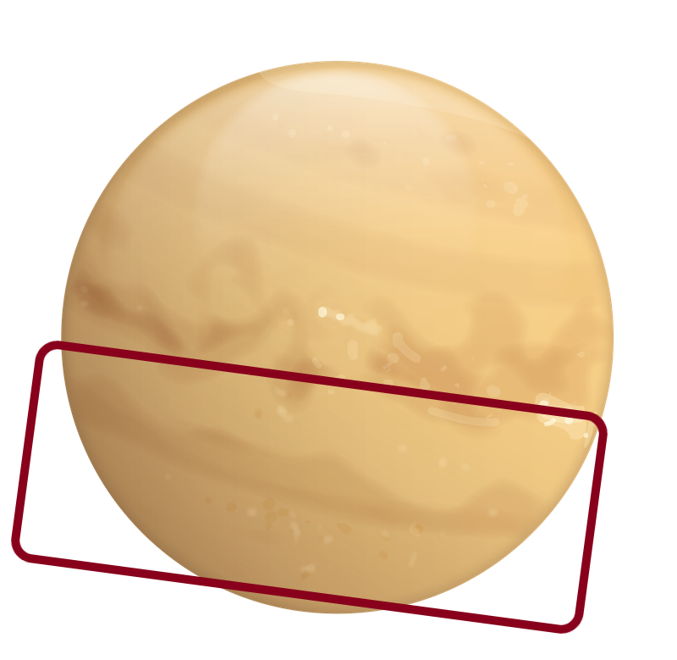
What are the downstream consequences of different construals?
Calibration > Intro/contrast > Construal > Possibility of change > Normativity > Intervention
Vawns live here, on this other side of the planet.
structural context
N = 132 adults on MTurk
~44/condition
Notes:
Structural context: environmental/residental segregation

Slide 36
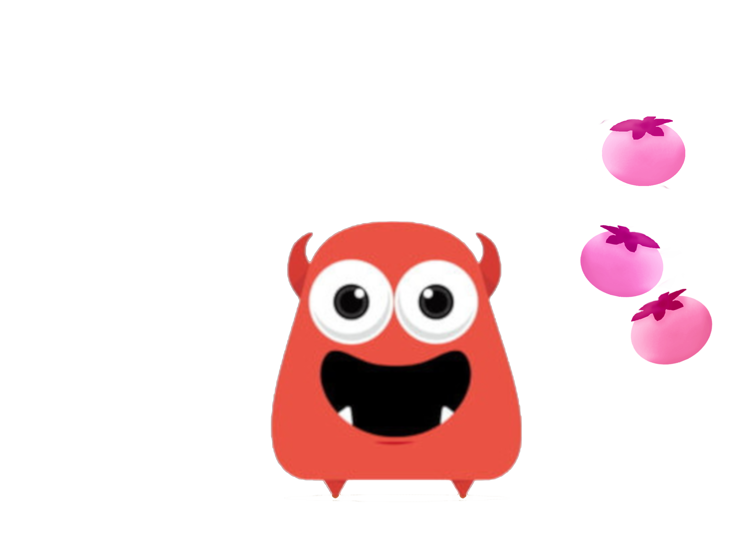
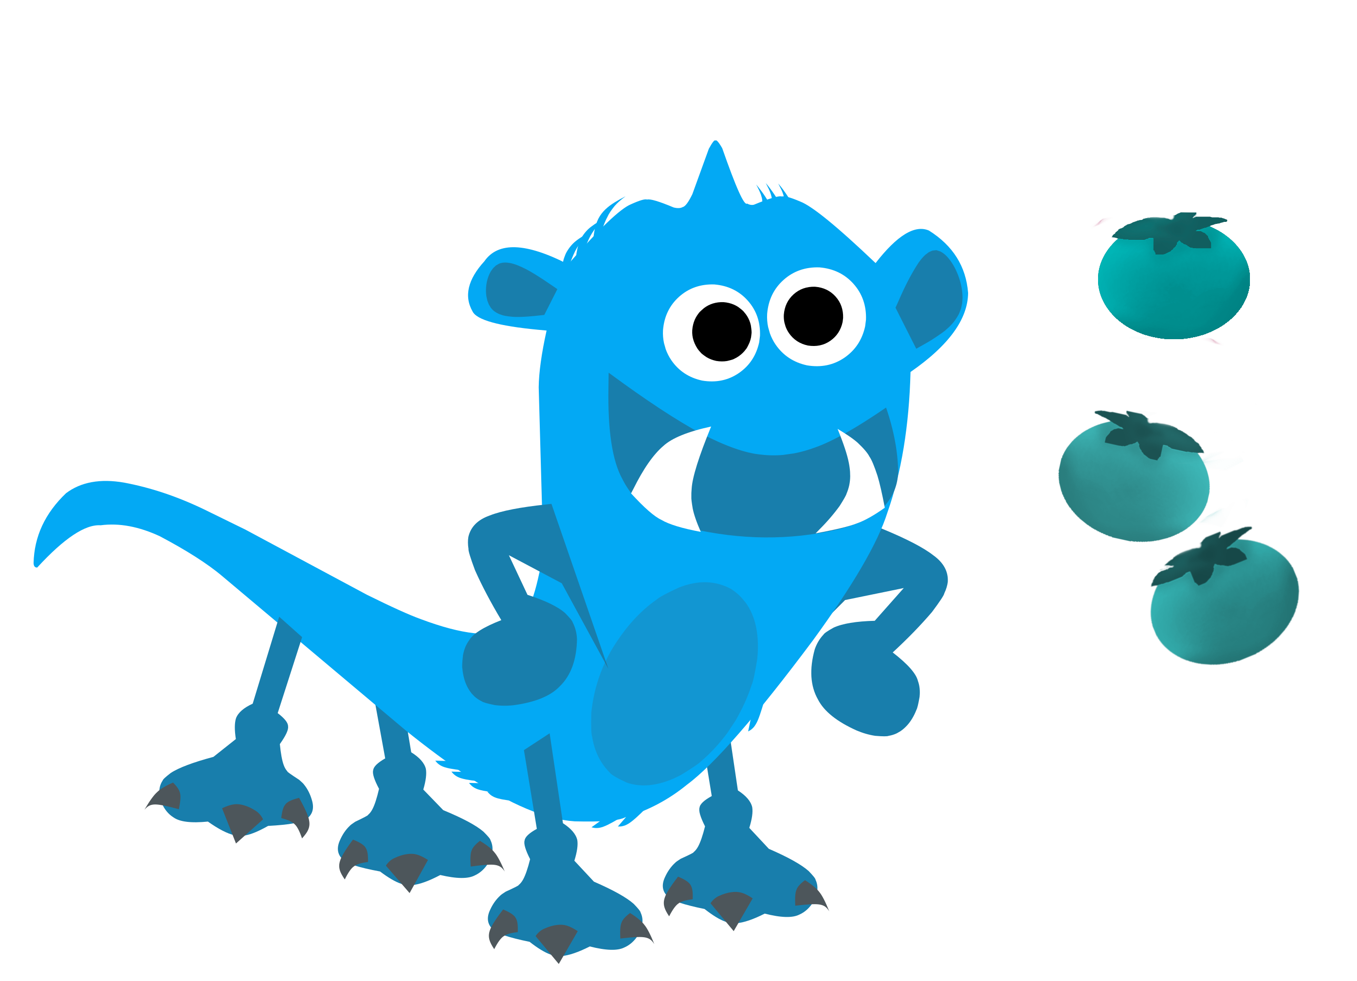
What are the downstream consequences of different construals?
Calibration > Intro/contrast > Construal > Possibility of change > Normativity > Intervention
Zarpies eat pogoberries. Vawns eat okinberries.
& novel neutral property
Generic statements:
convey relative frequency (Tessler & Goodman, 2019)
support multiple construals (Noyes & Keil, 2019/2020, Vasilyeva & Lombrozo, 2020)
N = 132 adults on MTurk
~44/condition
Notes:
Introduce a neutral novel property (eating berries) using generic statements.
We know from other work (MH Tessler) that generics can support various kinds of construals, and principly communicate that the idea that this category has a relatively higher frequency of this property than contrast categories. Sets up the disproportionate contrast we saw earlier with real-life examples

Slide 37
What are the downstream consequences of different construals?
Calibration > Intro/contrast > Construal > Possibility of change > Normativity > Intervention
Today we're going to learn about Zarpies!
N = 132 adults on MTurk
~44/condition
Notes:
Focus on a single group

Slide 38
What are the downstream consequences of different construals?
Calibration > Intro/contrast > Construal > Possibility of change > Normativity > Intervention
Participants randomly assigned to 1 of 3 conditions:
Internalist (biological)
Because of the way their bodies work, other berries make them sick, so Zarpies only eat pogoberries.
biology
cultural taboos
Internalist (cultural)
Because they believe eating other berries is bad luck, Zarpies only eat pogoberries.
availability / access
Structural
Because pogoberries are the only berries that grow in the area where they live, Zarpies only eat pogoberries.
eat pogoberries
N = 132 adults on MTurk
~44/condition
Notes:
Receive 3 different kinds of explanations, which induce 3 different construals

Slide 39
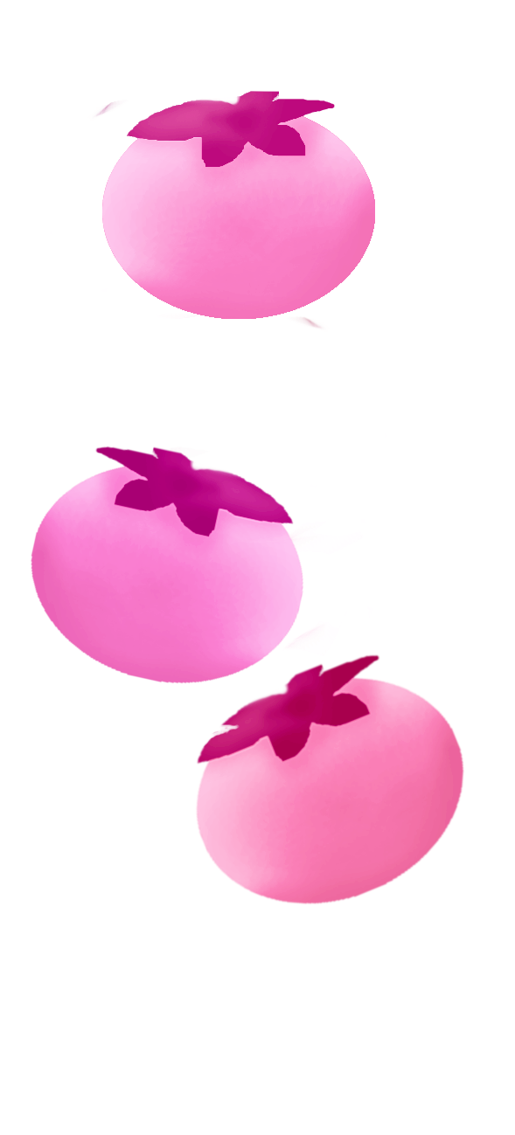
What are the downstream consequences of different construals?
Calibration > Intro/contrast > Construal > Possibility of change > Normativity > Intervention
Attention check (N = 6 excluded)
Which group usually eats okinberries?
(Zarpies,
Vawns)
N = 132 adults on MTurk
~44/condition

Slide 40
What are the downstream consequences of different construals?
Calibration > Intro/contrast > Construal > Possibility of change > Normativity > Intervention
Possibility of change
From traditional flexibility measures in development of gender stereotypes (Levy et al., 1995, Blakemore & Russ, 1997)
Can Zarpies also eat okinberries?
?
(For sure no, Maybe no, Maybe yes, For sure yes)
N = 132 adults on MTurk
~44/condition
Notes:
Possibility of change – is it possible for category members to be otherwise?
Modeled from gender stereotype dev literature (Levy et al, 1995, Blakemore & Russ, 1997). Traditional flexibility – whether gender/moral/social transgression is possible. Follows rule knowledge: “Which group usually plays with a toy kitchen? (boys/girls). Can boys also play with a toy kitchen? (Y/N)
Possibi

Slide 41
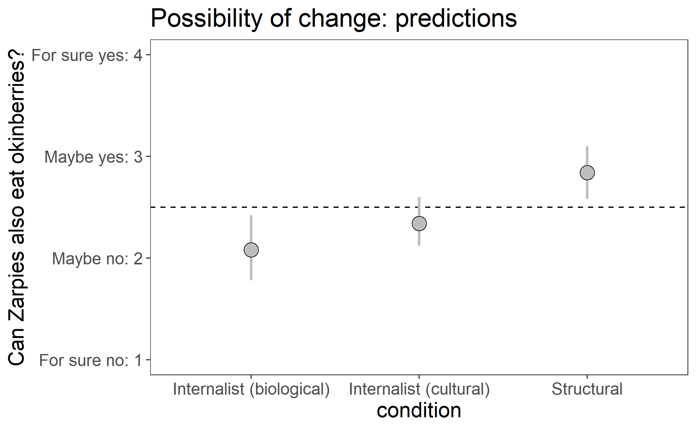
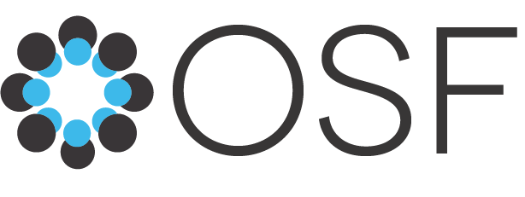
What are the downstream consequences of different construals?
Calibration > Intro/contrast > Construal > Possibility of change > Normativity > Intervention
?
Can Zarpies also eat okinberries?
Internalist (biological) < Structural
Internalist (cultural) maybe in the middle?
Notes:
PREDICTIONS

Slide 42
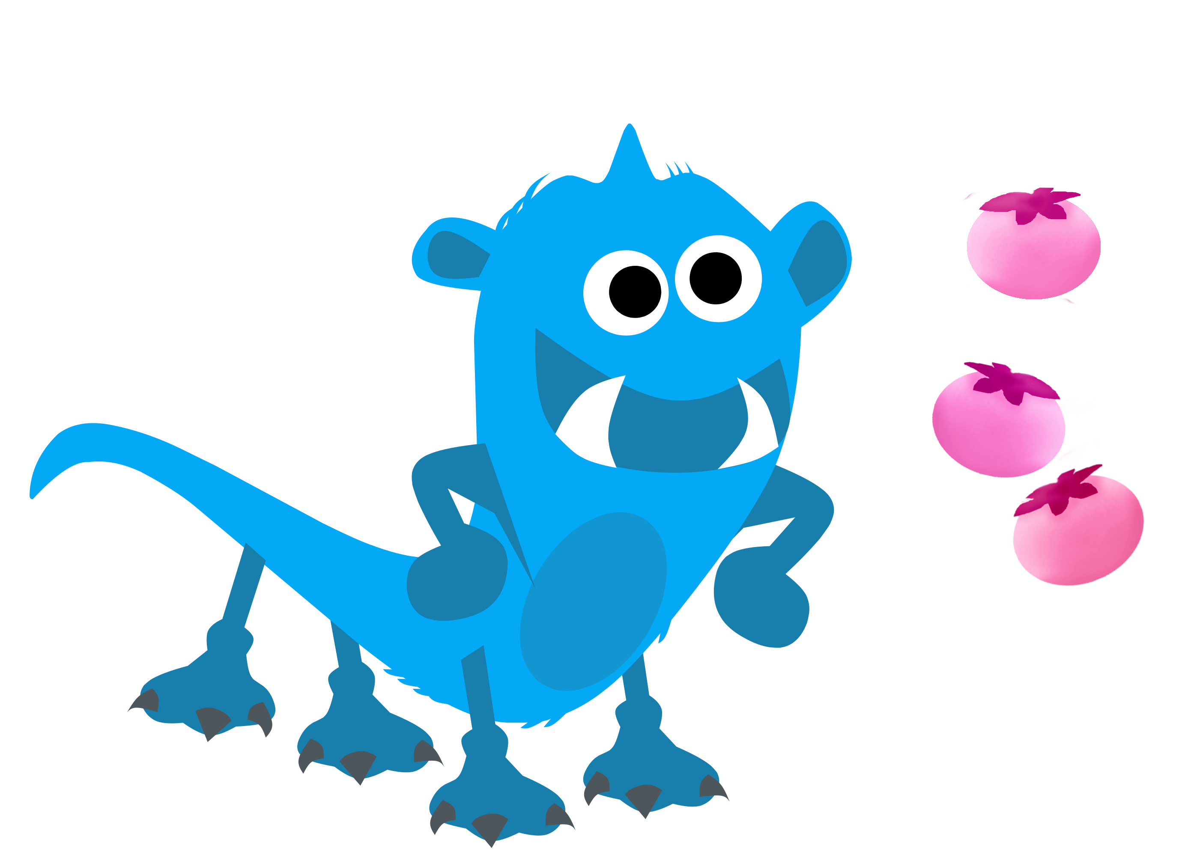
What are the downstream consequences of different construals?
Calibration > Intro/contrast > Construal > Possibility of change > Normativity > Intervention
Normativity (Roberts et al., 2016)
Look, here is a Zarpie who eats okinberries!
Is it okay or not okay for this Zarpie to eat okinberries?
forced-choice:
(Okay, Not okay)
(Very, very good, Pretty good, A little good)
(A little bad, Pretty bad, Very, very bad)
6-point:
N = 132 adults on MTurk
~44/condition
Notes:
2-step scale used extensively with 4-11yo by Steven
*who is eating okinberries
Roberts, S. O., Gelman, S. A., & Ho, A. K. (2016). So It Is, So It Shall Be: Group Regularities License Children’s Prescriptive Judgments. Cognitive Science, 41(S3), 576–600. https://doi.org/10.1111/cogs.12443

Slide 43
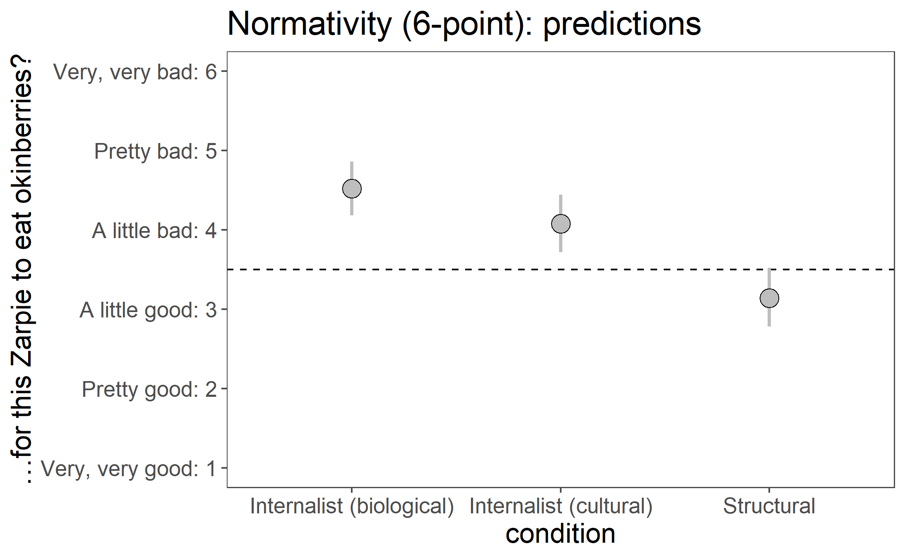
What are the downstream consequences of different construals?
Calibration > Intro/contrast > Construal > Possibility of change > Normativity > Intervention
…for this Zrpie to eat okinberries?
Internalist (biological) > Structural
Internalist (cultural) maybe in the middle?
Notes:
PREDICTIONS
biological: not okay – allergic reaction?
cultural: not okay – violating cultural norm, it’s haram, not kosher
structural: fine

Slide 44
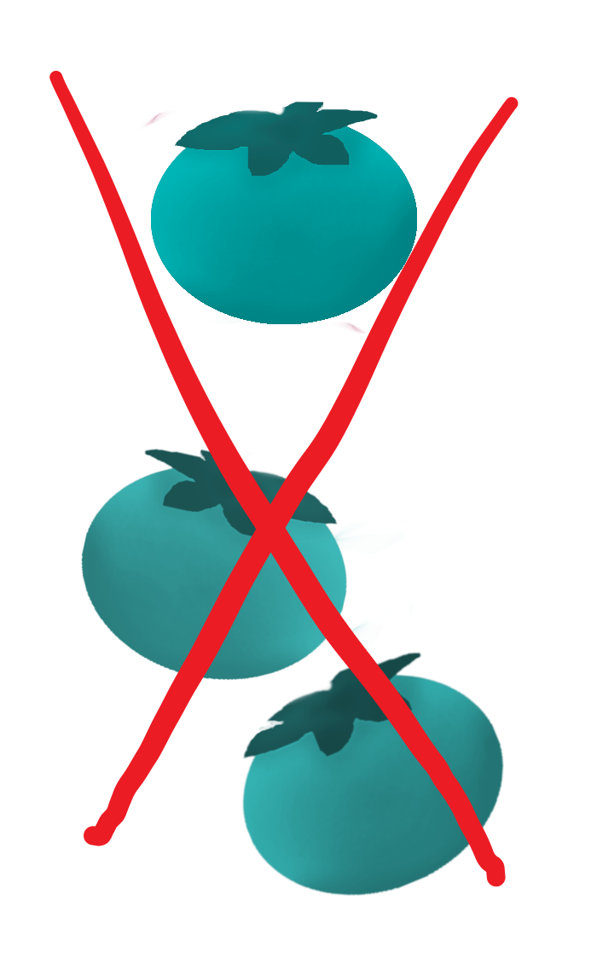
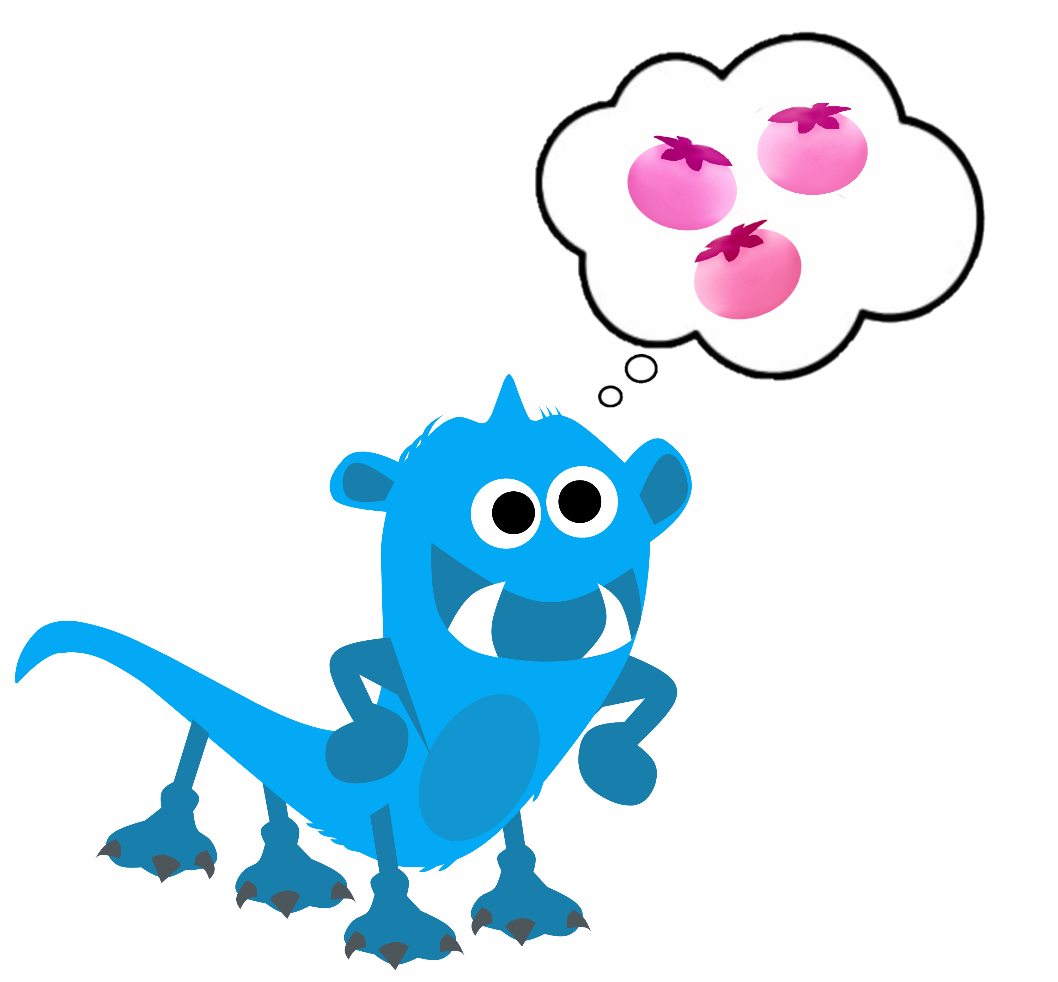
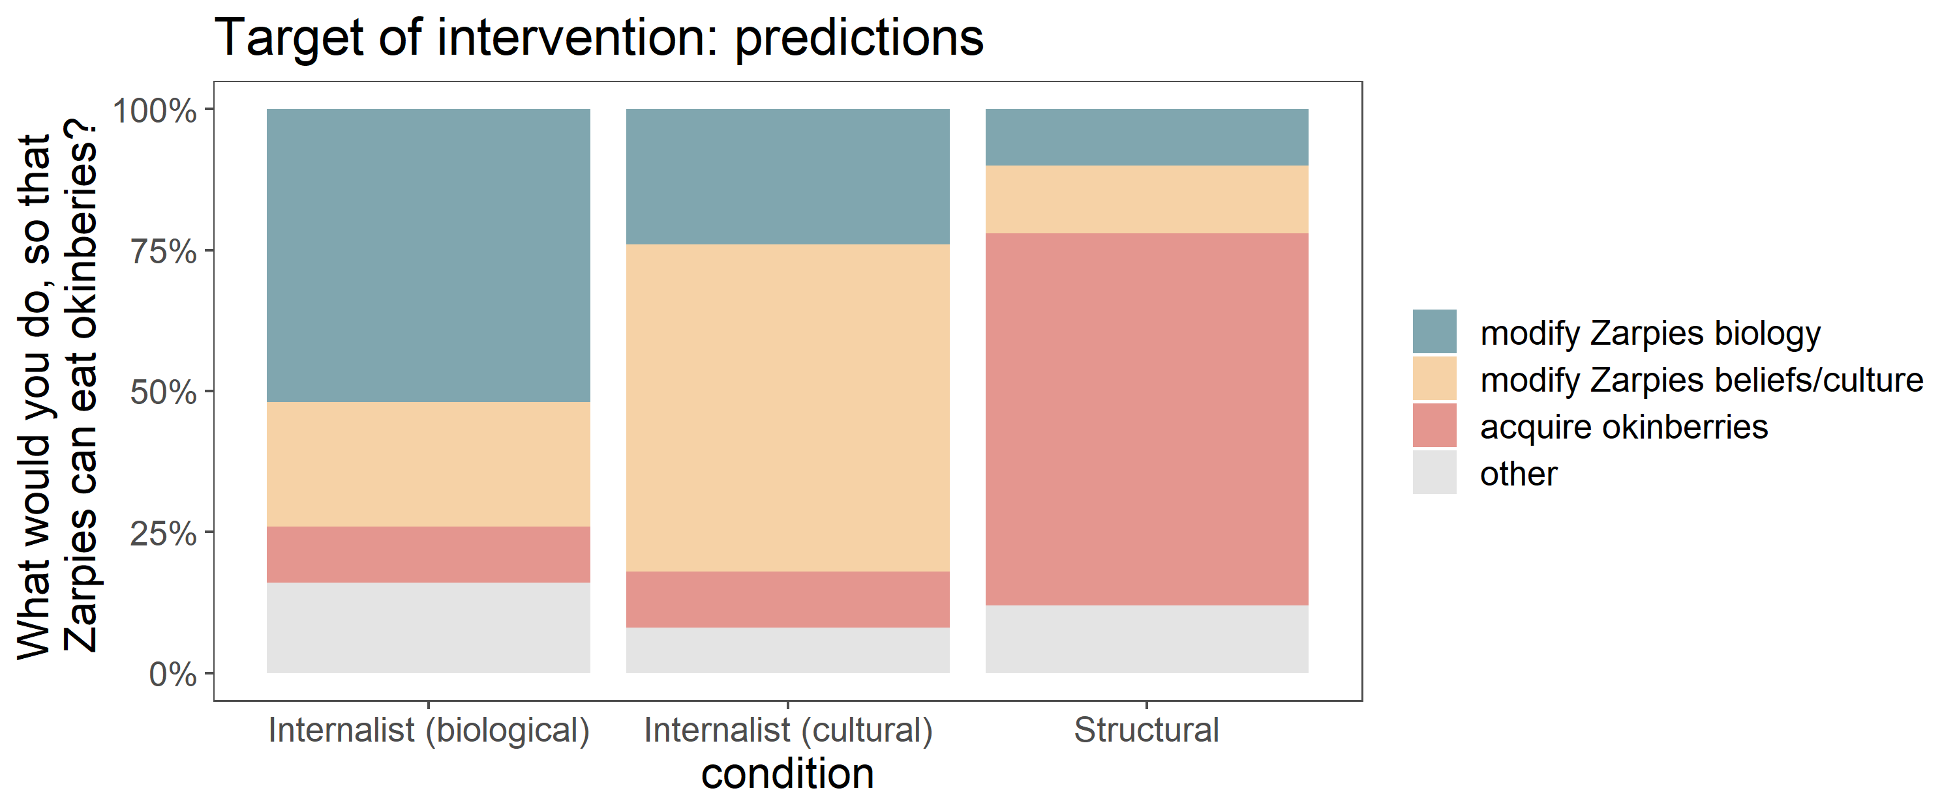
What are the downstream consequences of different construals?
Calibration > Intro/contrast > Construal > Possibility of change > Normativity > Intervention
Target of intervention
Oh no, the pogoberry harvest failed this year. The Zarpies need to eat okinberries.
If you could make anything happen, what would you do, so that the Zarpies can eat okinberries? Please list at least 1 specific action you would do.
open-ended
coding:
(pill, vaccine)
(teaching, awareness campaign)
(migrate, import, trade)

Slide 45
What are the downstream consequences of different construals?
Calibration > Intro/contrast > Construal > Possibility of change > Normativity > Intervention
Internalist (biological) > Structural
Internalist (cultural) maybe in the middle?
Notes:
Zoom annotate
Was not predicting modify okinberries – might be a product of difficulty of intervention (modify Zarpies biology is harder than modify okinberries).

Slide 46
What are the downstream consequences of different construals?
Calibration > Intro/contrast > Construal > Possibility of change > Normativity > Intervention
Difficulty of intervention
How easy or difficult would it be to do the action you suggested above? If you suggested more than one action, just rate the first action you listed.
(Very easy, Somewhat easy, Somewhat difficult, Very difficult)
N = 132 adults on MTurk
~44/condition
Notes:
Exploratory measure added in
*independent raters rate top few interventions: equated difficulty

Slide 47
What are the downstream consequences of different construals?
Calibration > Intro/contrast > Construal > Possibility of change > Normativity > Intervention
Attention checks
excluded
N = 11
In this task, what groups were mentioned? Check all groups mentioned. (Zarpies, Vawns, Hibbles, Glerks)
In this task, what berries were mentioned? Check all berries mentioned. (Pogoberries, Okinberries, Junpaberries, Hilaberries)
N = 9
This task involved:
(Learning about Zarpies and answering questions about them, Listening to music made by Zarpies and rating how the music sounds,
Translating the language of Zarpies into English,
Writing an essay about the political views of Zarpies)
N = 1
N = 132 adults on MTurk
~44/condition
Notes:
Excluded if failed any of these

Slide 48
What are the downstream consequences of different construals?
3 conditions: (between-subjects)
Internalist (biological) Internalist (cultural) Structural
Pilot data!
4 measures:
Possibility of change
Normativity
Target of intervention
Difficulty of intervention
N = 132 adults on MTurk
~44/condition

Slide 49
What are the downstream consequences of different construals?
possibility of change – normativity – target of intervention
?
Internalist (biological) < Structural
Internalist (cultural) maybe in the middle?
Notes:
PREDICTIONS

Slide 50
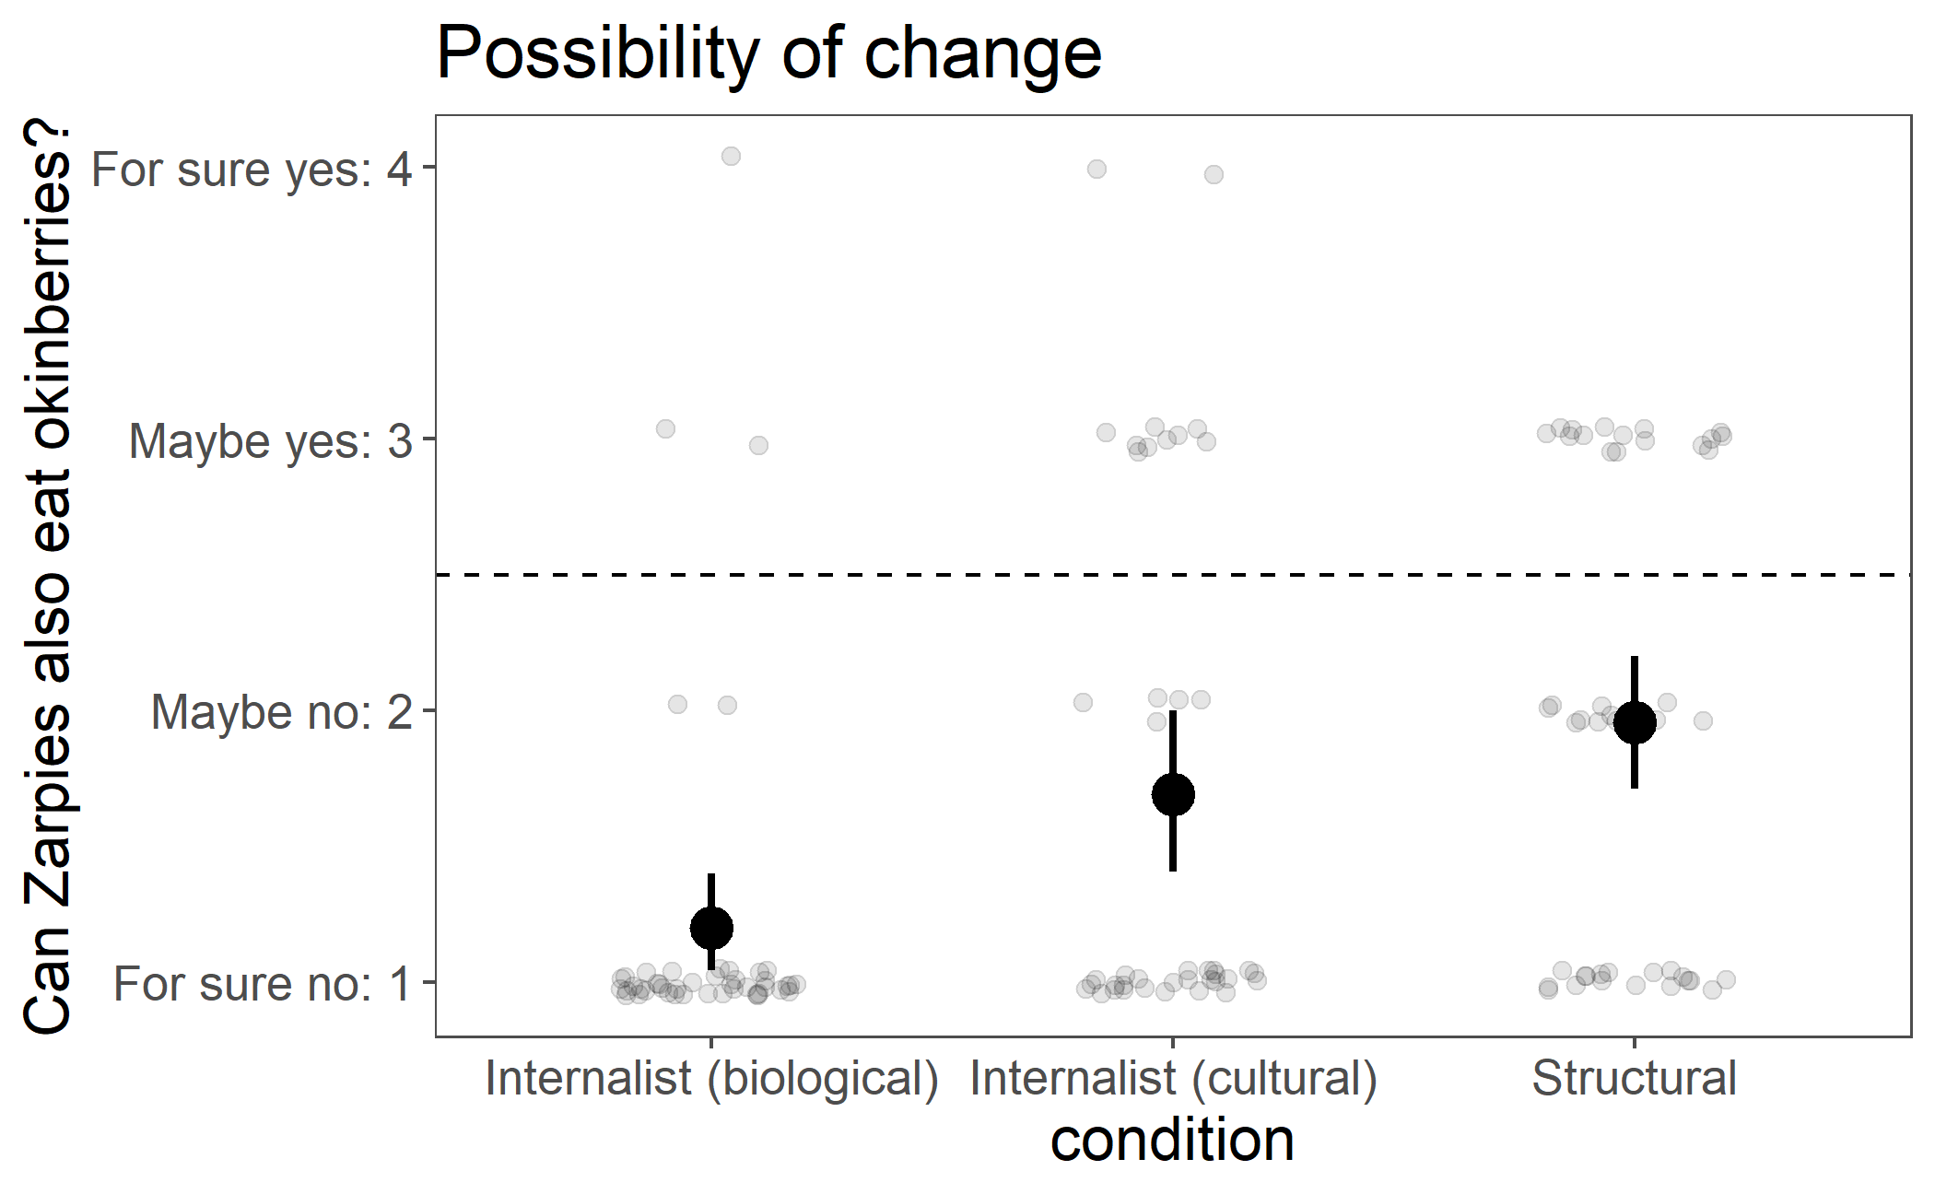
Structural construals allow for greater possibility of change.
***
**
BF = 19
p = 0.19
BF = 1.2
lm(possibility_change ~ condition)
brm(possibility_change ~ condition)
= 95% bootstrap CIs
N = 132 adults on MTurk
~44/condition
Notes:
remain significant after controlling for difficulty of intervention
*ELLEN: pretty low?
*DAVID: how are measures related? possibility judgments feed into counterfactual judgments, which drive intervention?

Slide 51
What are the downstream consequences of different construals?
greater possibility of change – normativity – target of intervention
Internalist (biological) > Structural
Internalist (cultural) maybe in the middle?
Notes:
PREDICTIONS

Slide 52
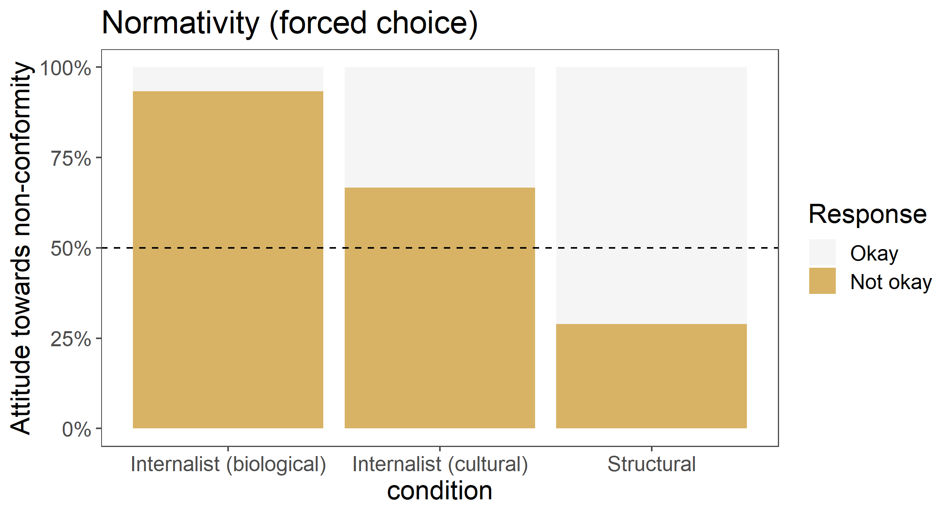
Structural construals decrease normativity.
N = 132 adults on MTurk
~44/condition

Slide 53
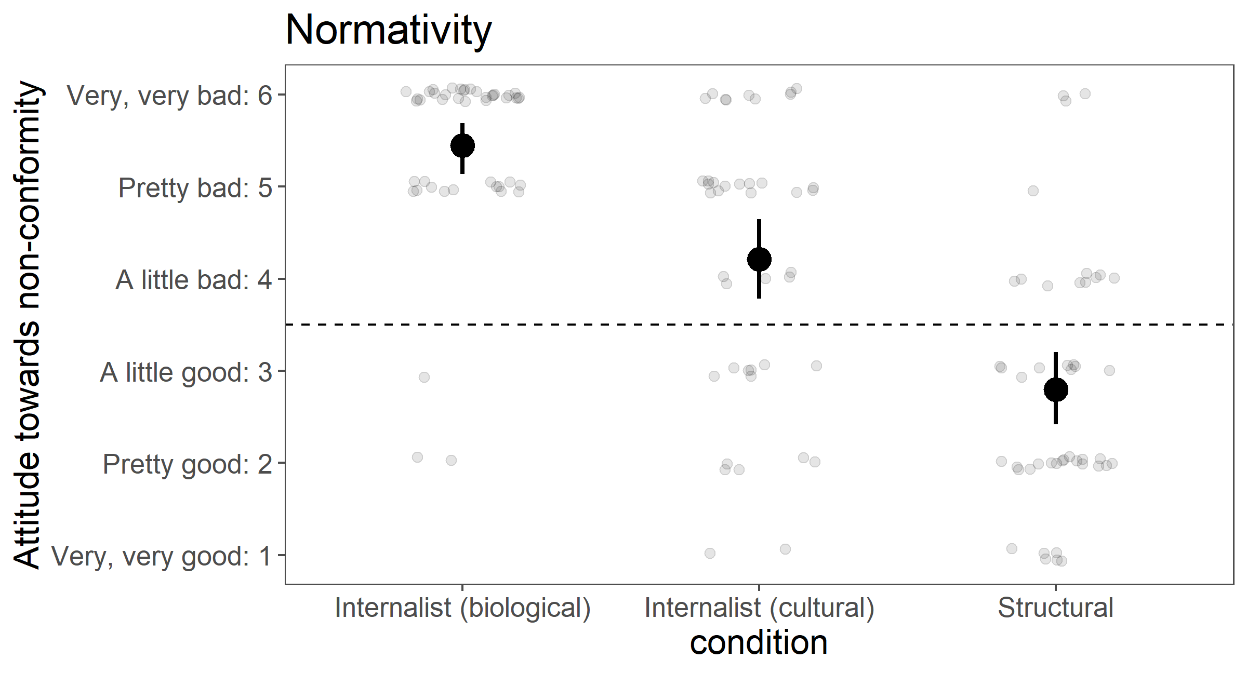
Structural construals decrease normativity.
***
***
lm(normativity ~ condition)
= 95% bootstrap CIs
N = 132 adults on MTurk
~44/condition
Notes:
Same pattern as fc

Slide 54
What are the downstream consequences of different construals?
greater possibility of change – less normativity – target of intervention
Pre-planned coding scheme
modify Zarpies biology
pill, vaccine
modify Zarpies beliefs/culture
teaching, awareness campaign
acquire okinberries
migrate, import, trade
other

Slide 55
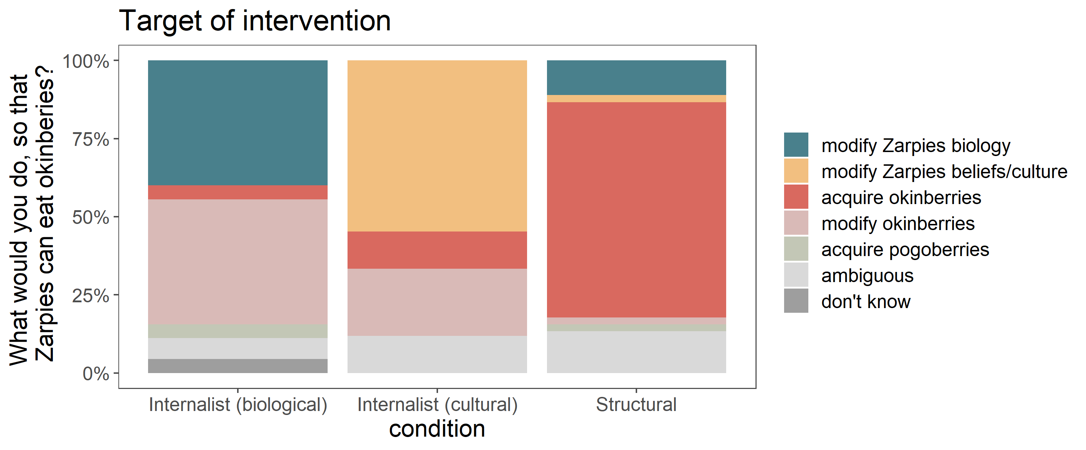
Actual interventions suggested
modify Zarpies biology
vaccine, potion, pill, medicine, build tolerance, cross-breed w another alien
modify Zarpies beliefs/culture
tell them it's not bad luck, tell them it's good luck, change their thoughts
acquire okinberries
grow/plant, import, trade, ask Vawns to send, search planet, tell them where to find, share with Vawns, travel, invade, visit Vawns, move to other side of planet, switch spots with Vawns
modify okinberries
change their color, wash them, heat up, cook them, prepare them, remove part, mix with something else, sanitize
acquire pogoberries
ambiguous
magic spell that allows them to eat okinberries, give seeds, ask someone for them, be friendly with others, make it to where the okinberries don't make the Zarpies sick, have it not be poisonous, Will harvest again and cultivate it, establish hospitals for Zarpies when they get sick, Zarpies will try to eat okinberies, too far away
don't know
N = 132 adults on MTurk
~44/condition
Notes:
What did participants come up with for intervention?
Coding scheme, just coded myself without looking at condition
Was not predicting modify okinberries

Slide 56
Notes:
Annotate in lieu of gghighlight
Was not predicting modify okinberries – might be a product of difficulty of intervention (modify Zarpies biology is harder than modify okinberries).

Slide 57
Structural construals shift the focus of intervention to the structural context.
N = 132 adults on MTurk
~44/condition
Notes:
Zoom annotate to highlight
Was not predicting modify okinberries – might be a product of difficulty of intervention (modify Zarpies biology is harder than modify okinberries).

Slide 58
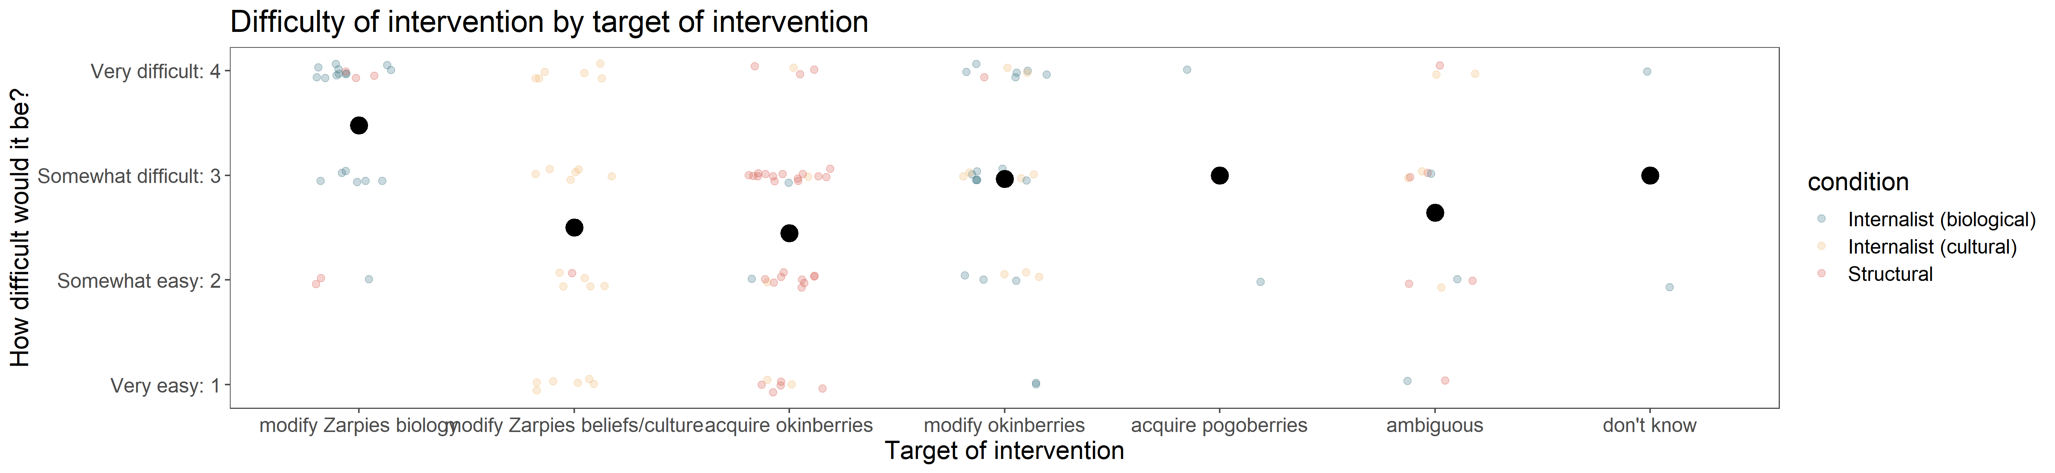
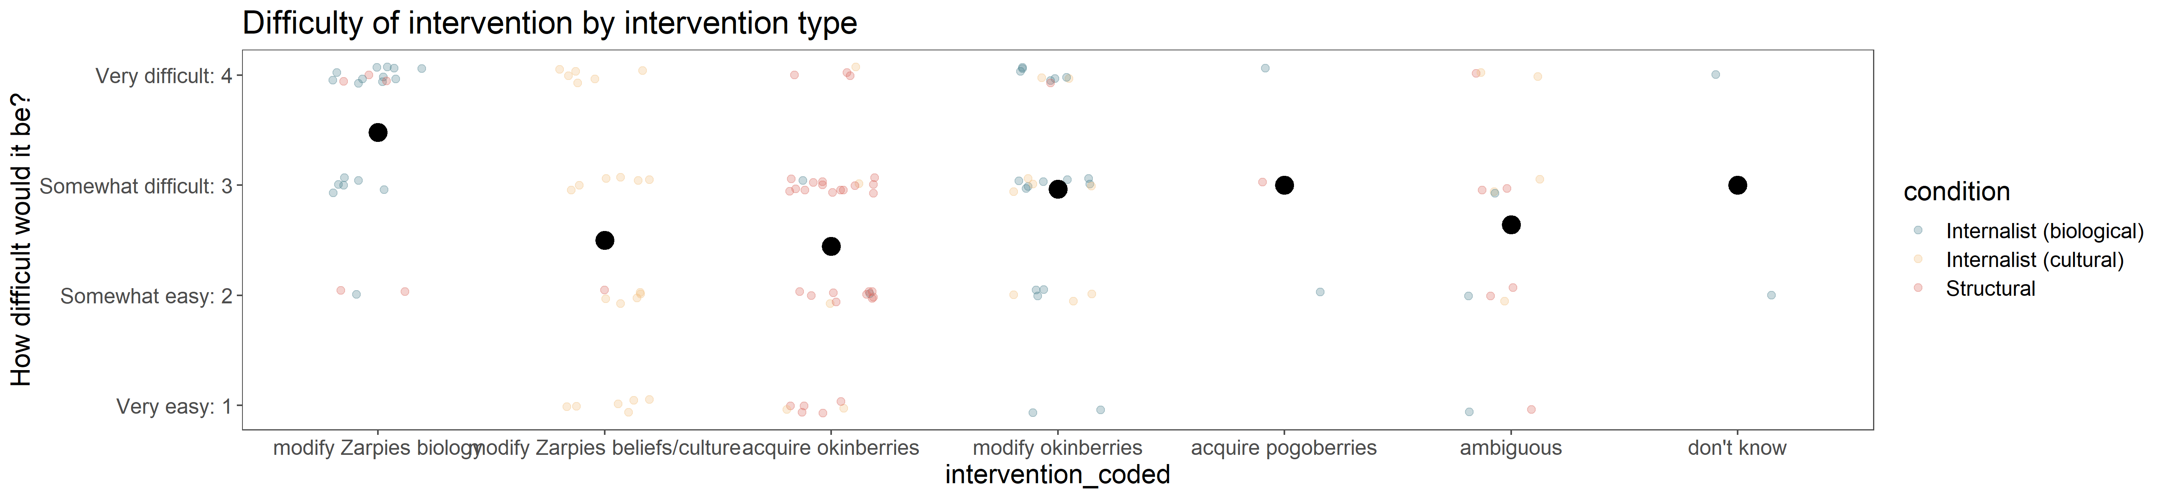
What are the downstream consequences of different construals?
greater possibility of change – less normativity – intervene on structure
Previous results hold after controlling for difficulty of intervention.
Interventions vary in difficulty.
lm(X ~ condition + intervention_diff)
modify Zarpies biology is pretty difficult
modify Zarpies beliefs/culture, acquire okinberries are not as difficult
Notes:
Correspond to the particular stimuli used in this experiment, not making the claim that in general, biological causes are harder to intervene on than structural causes.
Can think of structural causes that seem really difficult to change: housing segregation.
Can think of biological causes that are easier to change: taking a lactase pill

Slide 59
causes internal to individuals in group
biology, personality, disposition
Biological
Internalist
causes external to an individual but internal to the group
culture, shared values/beliefs
Cultural
causes external to the group
policies, discrimination, environment, social/economic systems
Structural
What are the downstream consequences?
Normativity What should be the case?
Possibility of change Is it possible for things to be otherwise?
Target of intervention How might we change what is the case?

Slide 60
causes internal to individuals in group
biology, personality, disposition
Biological
Internalist
causes external to an individual but internal to the group
culture, shared values/beliefs
Cultural
causes external to the group
policies, discrimination, environment, social/economic systems
Structural
What are the downstream consequences?
Structural construals may:
decrease normativity
increase possibility of change
shift the target of intervention to structures rather than individuals

Slide 61
causes internal to individuals in group
biology, personality, disposition
Biological
Internalist
causes external to an individual but internal to the group
culture, shared values/beliefs
Cultural
causes external to the group
policies, discrimination, environment, social/economic systems
Structural
What are the downstream consequences?
Structural construals:
It’s okay for things to be different.
It’s possible for things to be different.
If we were to make things different, let’s change structures.
Notes:
Explain like I’m 5 summary
Implications of representing categories in different ways – eg incarceration

Slide 62
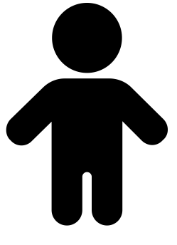
Future thoughts
Why?
Why?
Run adults for real… also children!
Additional downstream consequences from these construals
motivation for change
Building up to more complex (and common) models with different levels and types of causes interacting with each other
When structural contexts are caused by another group
How to communicate structural construals?
+/-
Interactions with property valence
Notes:
5-6yo - likely exaggerated patterns for possibility of change (stereotype rigidity), and normativity (hair-trigger normativists in Steven’s work)
Motivation for change – here focused on whether it’s possible to change, and if you could change what would you do, but didn’t get at how motivated people would be to intervene. Social justice rn - discouraged when possibility of change seems impossible, eg system seems impossible to change
Complex models – eg even with eating habits: biology/culture interactions (eg lactose intolerance and the presence of dairy in various cuisines), culture and environmental context interactions (eg local availability of plants, ingredients used in traditional cuisines)
Property valence – examples were negative, here novel neutral property.

Slide 63
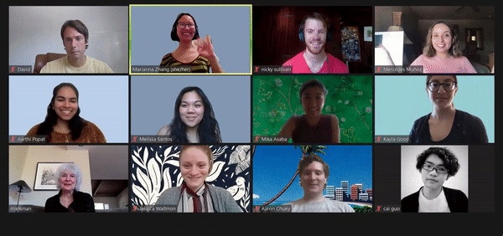


Thanks!
Thanks!
Adult pilot participants on MTurk
Markman lab meetings
Thurs 9-10:30am Pacific
on Zoom
https://mailman.stanford.edu/mailman/listinfo/markman_lab
markmanlab.stanford.edu
github.com/mariannazhang/ structural-consequences
osf.io/hz76n
mariannazhang.github.io
Notes:
devo area, cohort, dept for being so welcoming, helping me feel like I belong in community * how are generics and formal explanations related? Hunch: intimately related, open question exactly how. formal explanations do generically invoke the category. My guess is that formal explanations build on generics, going further by specifying that the category is somehow *the reason* for possessing the property, which allows them to be explanations rather than just statements. Would be interesting to probe when each are produced.
* variability at category level (what categories are essentialized), property level (what properties are essentialized for a given category, or tend to be essentialized across categories). Thinking about ess vs soc-str construals as a continuum, with intermediate
* relate to social attribution - something about the internal character, or something about the general situation. Social-structural forces aren’t just present for an individual in a one-time situation, these are stable forces acting on a category by virtue of the whole social context that it exists within
* vicious circle - social-structural context -> inherent properties, eg preference -> reinforce the very social-structural contexts that produced them (eg dept stores: lots of pink for girls' clothing, girls develop preference for pink, stores justify it in that there's demand for those clothes). structural contexts could end up reflecting something internal. Reasoning about root causes, inherence heuristic (Cimpian), statistical confound of context and inherent properties, contingency vs necessity.

Slide 64
Backslides

Slide 65
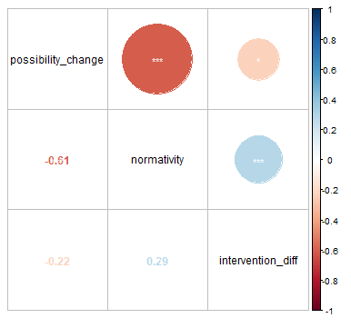
Correlations:
4 measures:
Possibility of change
Normativity
Target of intervention
Difficulty of intervention
Notes:
Spearman’s rank correlation rho

Slide 66
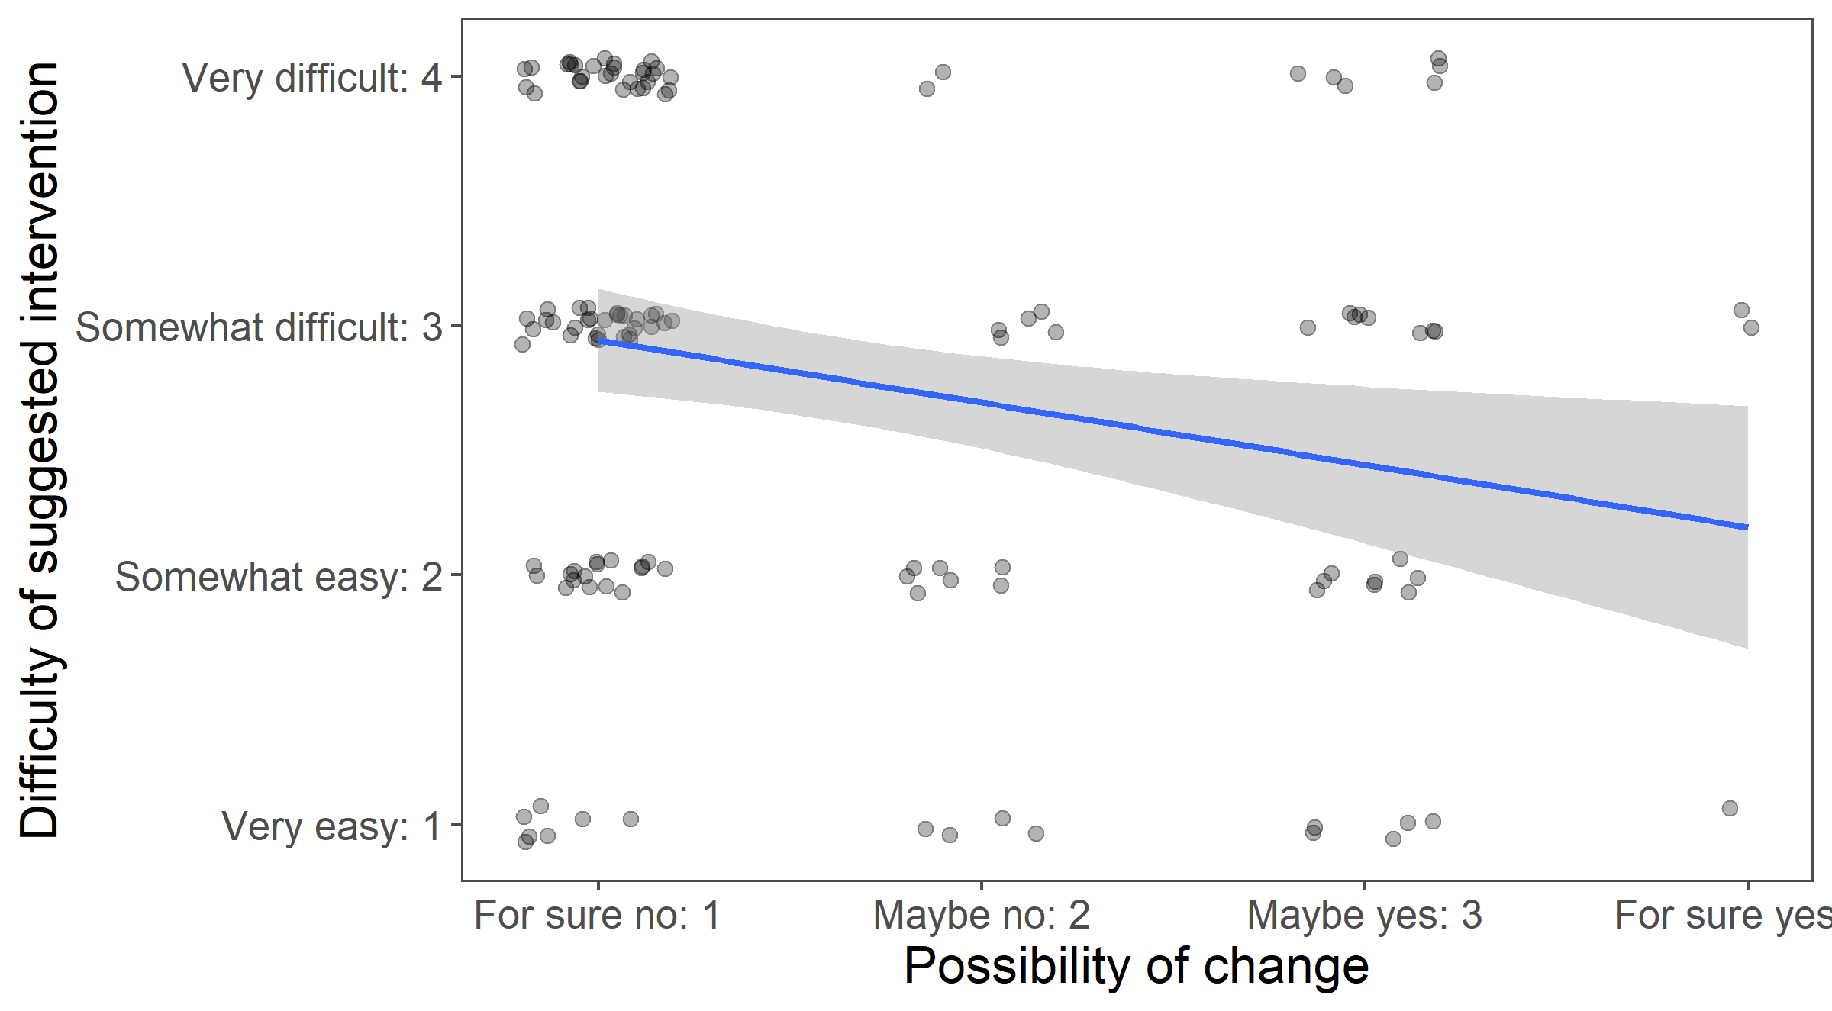
Higher possibility of change ~ lower difficulty of intervention
Spearman’s ρ = -0.24*
Notes:
Spearman’s rank correlation rho

Slide 67
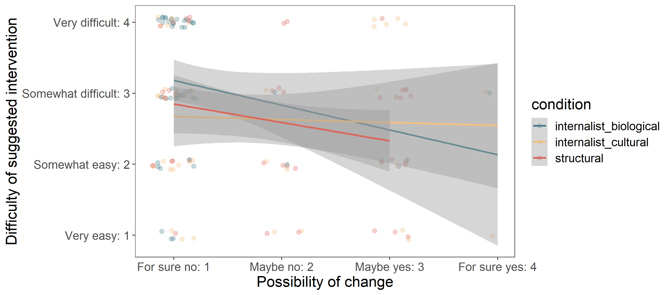
Higher possibility of change ~ lower difficulty of intervention
Spearman’s ρ = -0.24*
Notes:
No interaction with condition

Slide 68
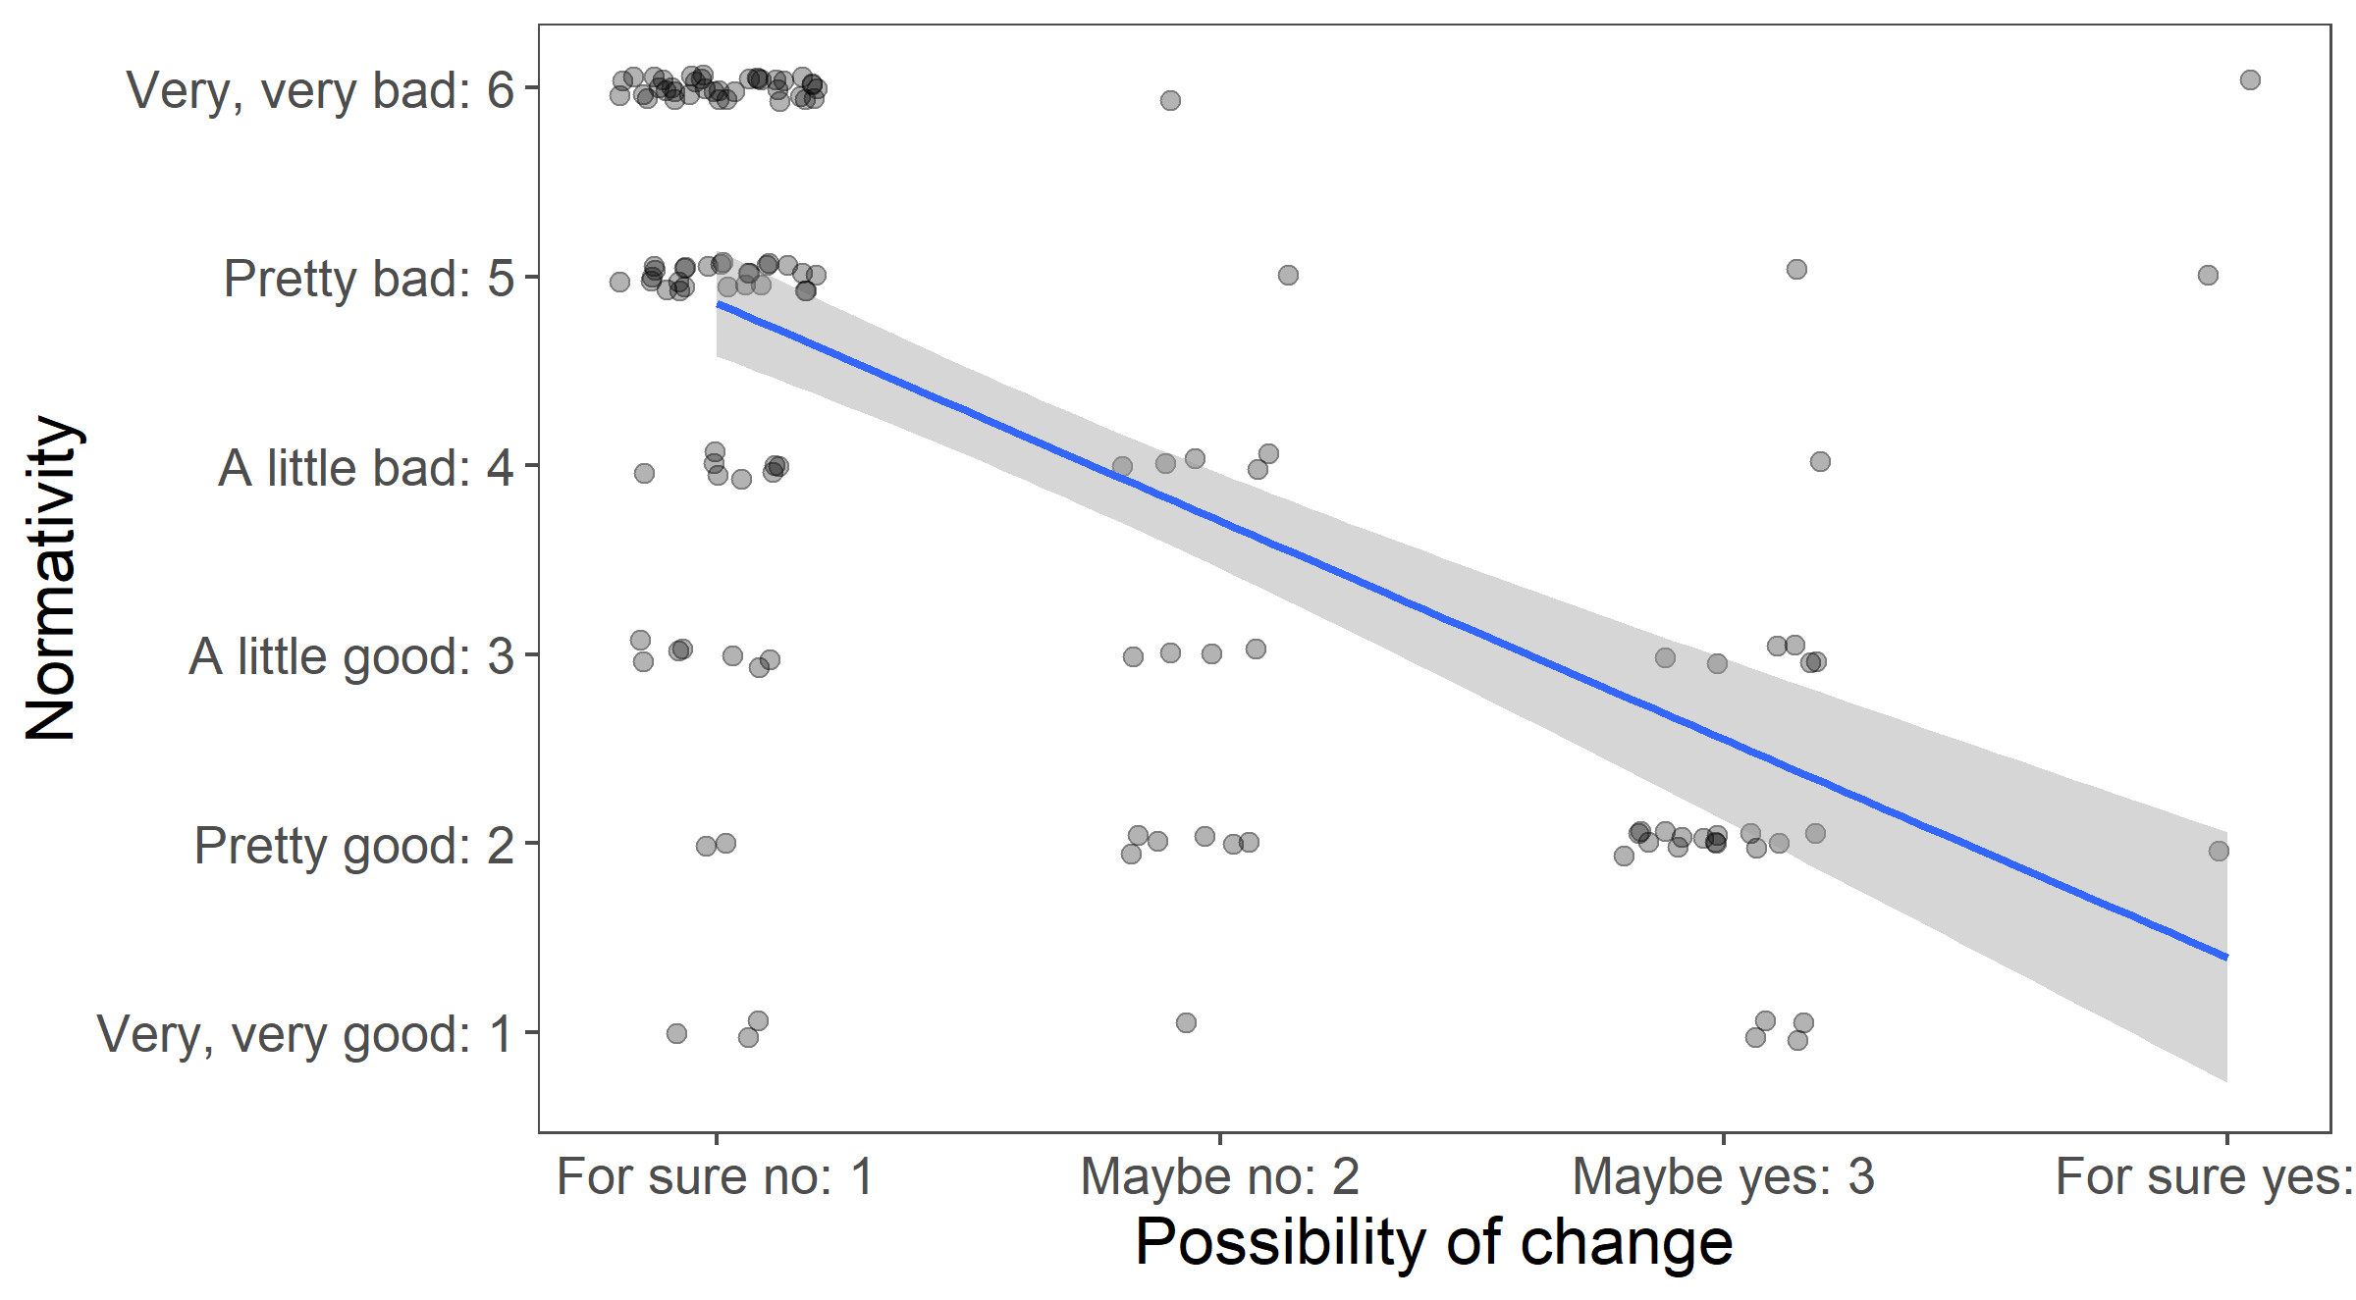
Higher possibility of change ~ lower normativity
Spearman’s ρ = -0.63***
Notes:
Spearman’s rank correlation rho

Slide 69
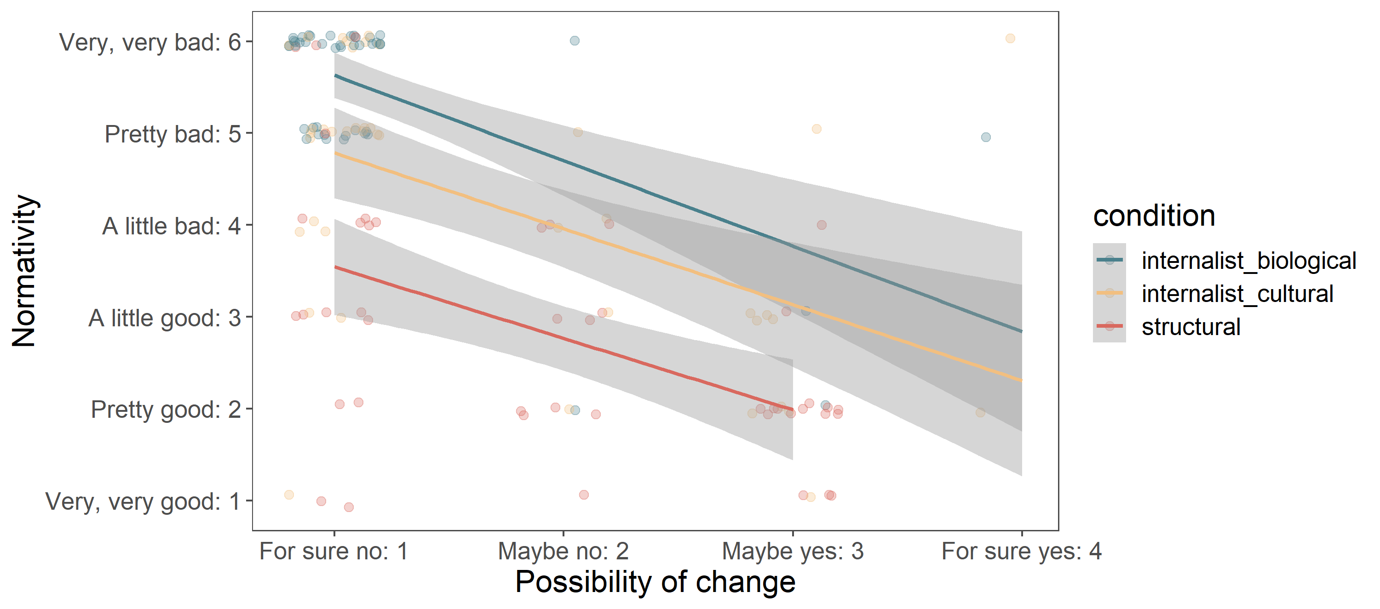
Higher possibility of change ~ lower normativity
Spearman’s ρ = -0.63***
Notes:
No interaction with condition

Slide 70
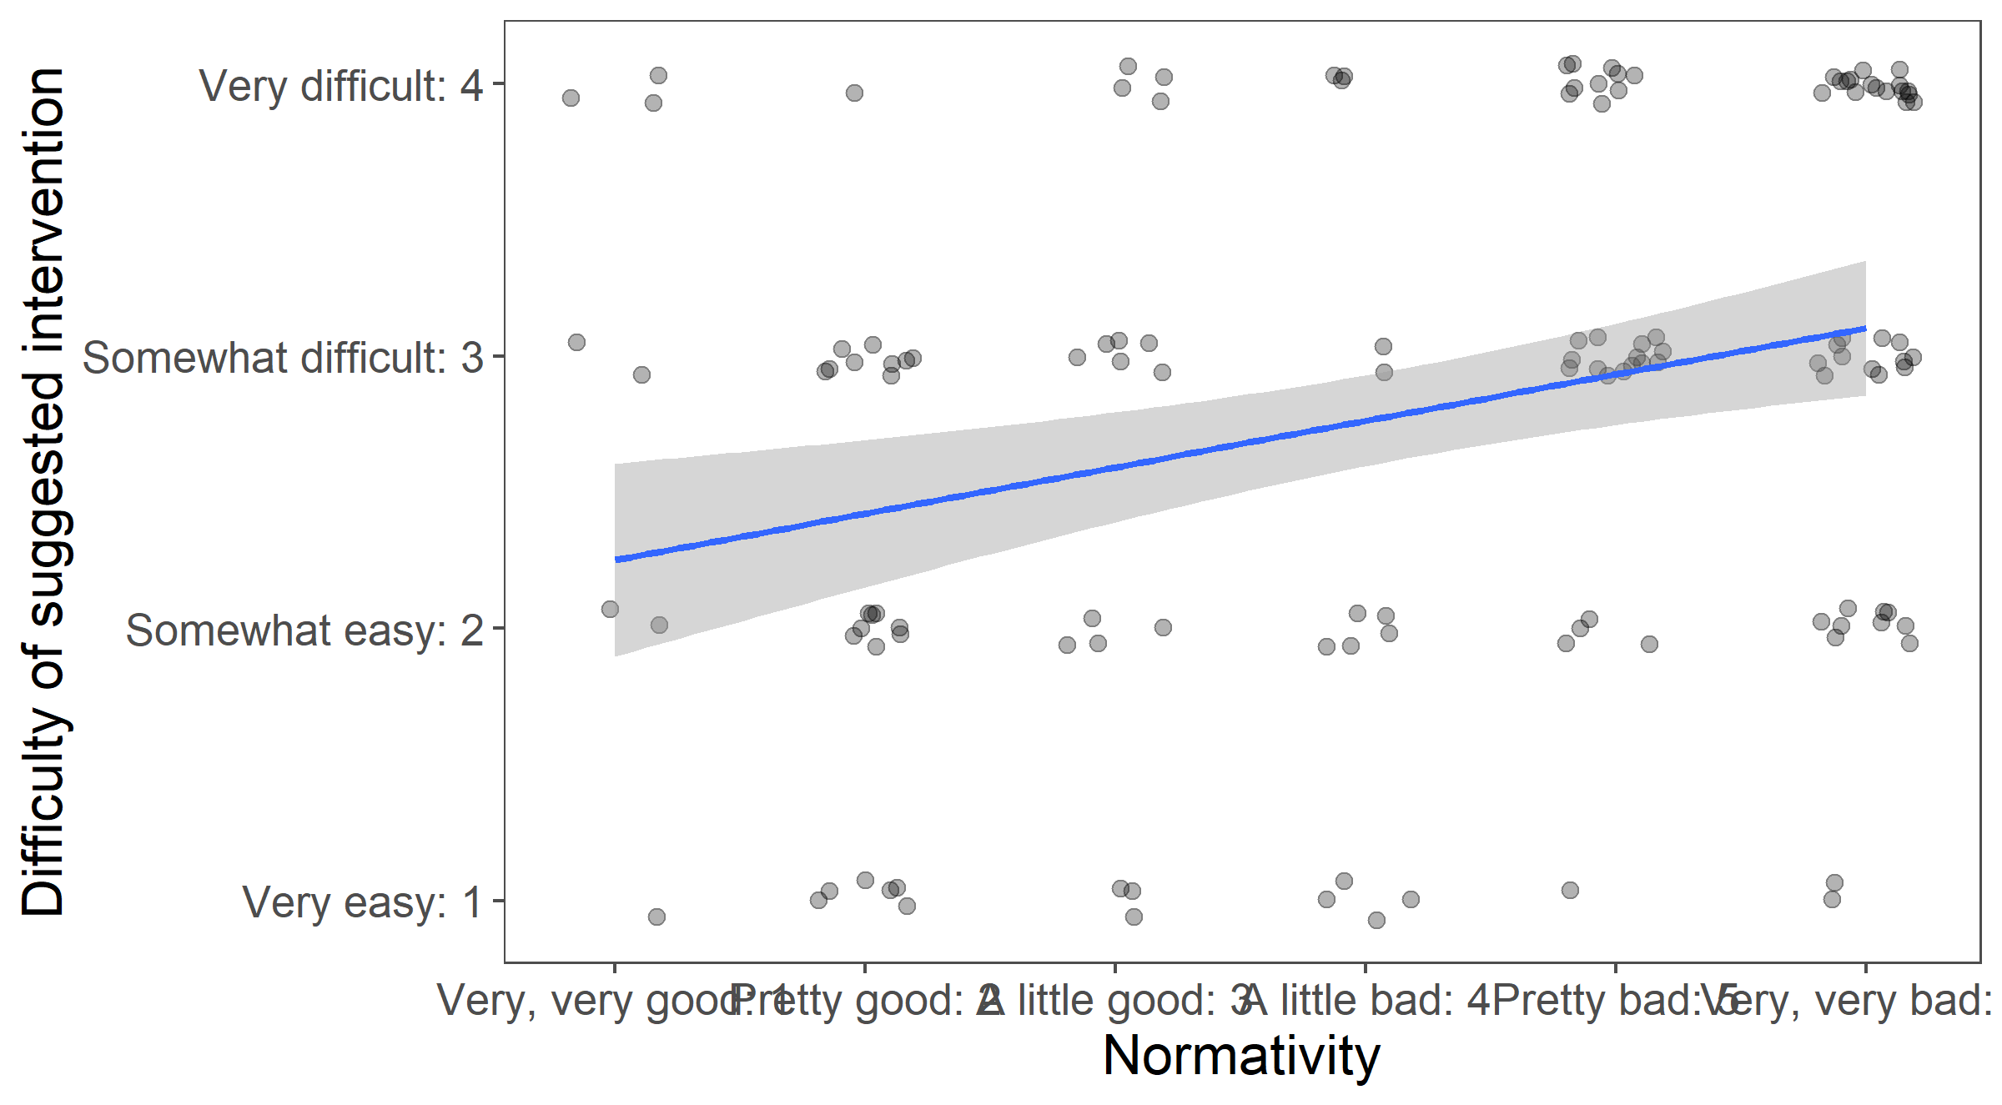
Higher normativity ~ higher difficulty of intervention
Spearman’s ρ = 0.29***
Notes:
Spearman’s rank correlation rho

Slide 71
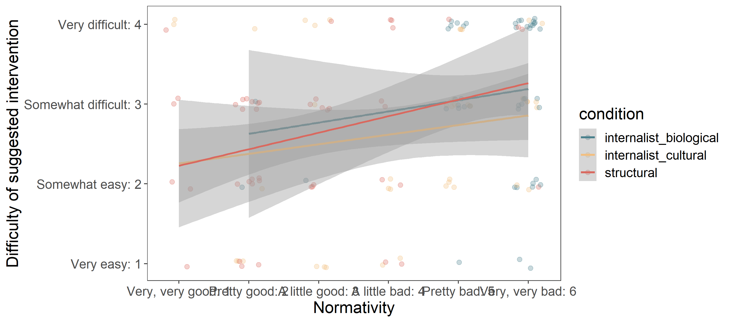
Higher normativity ~ higher difficulty of intervention
Spearman’s ρ = 0.29***
Notes:
No interaction with condition

